Slide 1
VN 057 Intro to Gerontology

Slide 2
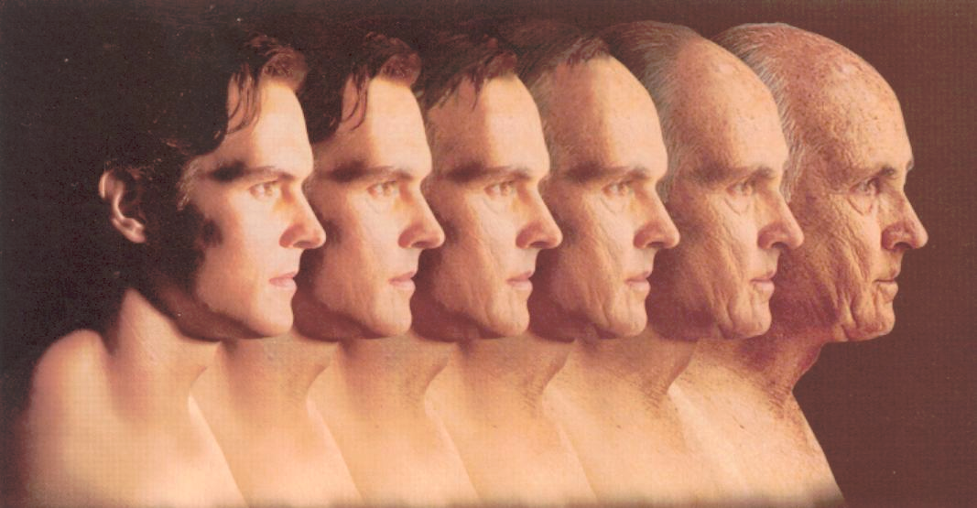

Slide 3
Categorizing the Population
55-64 older
60-74 young-old
65-74 elderly
75-84 aged
75-84 middle-old
85+ extremely aged
85+ old-old

Slide 4
Attitudes About Aging
Role of the family/society
Ageism-myth vs fact
Social
Family
Jobs
Health care
Gerontophobia: Fear of aging
Can be extreme

Slide 5
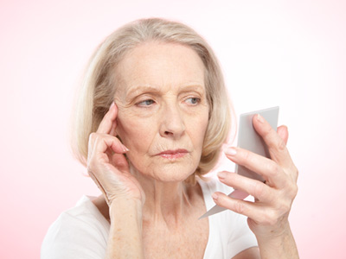

Slide 7
Demographics
Life expectancies-Historically
Biblical times 20 years old
1776 35 [though 65+ not uncommon]
1900 47 [4% of pop. >65]
2000 77.4 [13% of pop>65; 4%>85]
Effects of improved sanitation, immunization, healthcare

Slide 8
Demographics
What does greater numbers of older and elderly people mean?
1st time in history: Number of >65 is greater than number of children <5 years old.
Social security
Medicare
What do you think?

Slide 9
Demographics
Gender and ethnic disparity
Gender
Women outlive men by an average of 7 years
Ethnicity
White women:81 black women: 76.9
White men: 76 black men: 70
Hispanic & Asian variable, often depends on how long they’ve been in US
?what do you think???
Disease risk

Slide 10
Baby Boomers
The largest single cohort in history
1946-1964
Started retiring in 2011
One third of US population today
By 2029, all will be retired
Causes the older population to be twice the size as it is today

Slide 11
Baby Boomers
The good, the bad and the ugly...
Influence on all areas of society through their life span
How?

Slide 12
Boomers
Informed consumers
More technologically advanced
Retirees in 2008
43% use internet
Retirees in 2009
77% use internet

Slide 13
US Geography
Most elderly live in
CA, TX, IL, MI, OH, PA, NY, NJ, FL
Least in
Mid-west, north and mountain states

Slide 14
Education
Average educational level
Changed dramatically over last 30 years
1970
28% of people >65 graduated from high school
2008
78% had HS diploma
21% had Bachelor degree or higher
27% of men
16% of women

Slide 15
Income After Retirement
2007 median incomes [½ make more, ½ less]
Households: $43,159
Men: $24,142
Women: $13,877
Income disparity when working
Housewife's [or lower earning spouse] dilemma
P husband's death, wife gets ½ whatever
husband received in social security

Slide 16
Income Sources
Work
Social Security
Future of social security
Based on income
savings/investments
Pensions
2007 about 1/3 receive at least some pension
Ave Public: $16,629
Ave Private: $7,200

Slide 17
Landmark Legislation
1965: medicare & medicaid
1967: age discrimination act
1972: SSI & social security indexed to inflation.
1972: Older adult nutrition act
1990: ADA
2006: Medicare drug act
2012: Affordable care act

Slide 18
Politics/Lobbies
AARP
Major political force
NCSC:National Council of Senior Citizens
NASC:National Alliance of Senior Citizens
OWL: Older Women's League
GRAY PANTHERS
Public awareness & demonstrations

Slide 19
Wealth
Discuss in small groups
Frugal vs. Poor
Home ownership: Positive and negative
Income vs savings
Discretionary vs non-discretionary spending

Slide 20
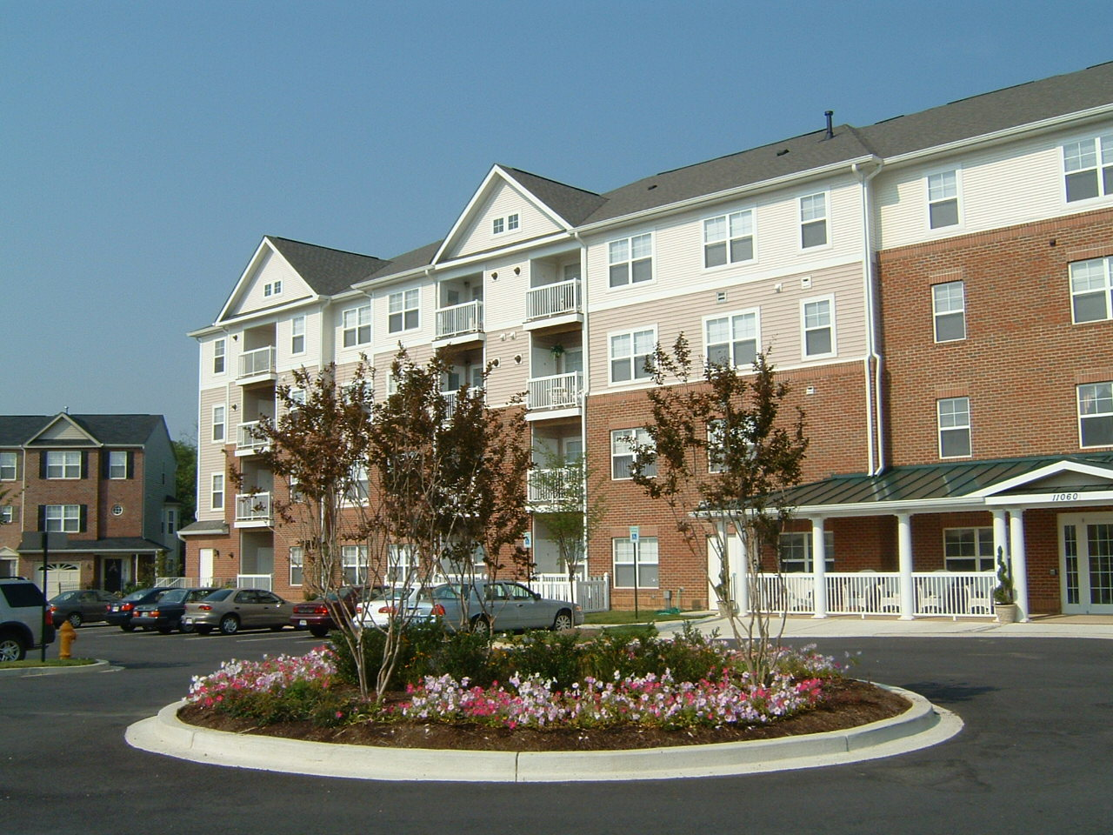
Housing

Slide 21
Independent Housing
Fully independent
Intermittent caregivers
FT or live in caregivers
Family
Own house or apartment
Rented house or apartment
Gvt subsidized

Slide 22
Housing-Mostly Independent
Group housing
Can be independent or assisted
Senior Housing
Can be independent or assisted

Slide 23
Modified, Non-Institutional
Community based residential
Group housing
Can be independent or assisted

Slide 24
Other housing
Institutional
Assisted living
Skilled nursing
Combination
Life Lease
Life care

Slide 26
Medicare
Elderly and/or permanent disability
Comes with social security
Pays 80% UCR fees
Part A
Inpatient hospital
DRG's

Slide 27
More Medicare
B, C and D premiums are optional and taken out of SS check
Part B
80% UCR Outpatient and MD office
Part C
HMO
Capitulation and co-pay
Part D
Drug benefit-varies wildly by plan

Slide 28
Medicare
Part b
outpatient and MD-80% ucr fees
Part c-HMO
Capitulation usually with fees
Part d-drug benefits

Slide 29
??????
How many of you have ever been uninsured?
Without a 2ndary insurance you will owe 20% after medicare
How much does an office visit cost?
ER visit for chest pain?

Slide 30
Supplemental Insurance
Private medicare supplement insurance
Medicaid
Medi-cal in CA
Asset and income based
If you own a house and receive benefits after
the age of 55-the state takes your house
when you die

Slide 32
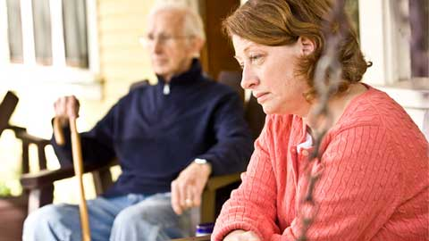

Slide 33
Impact on Family
Societal changes
Demographic changes
Smaller families
Sandwich generation
re-location
Cultural differences
Expectations re responsibility for care
Changes with acculturation

Slide 34
Impact on Family
Spending time with children
wisdom
Caregiver stressors
Physical
Emotional
financial

Slide 35
Abuse and Neglect
Self Neglect
Family or caregivers
Physical abuse [includes sexual]
Emotional abuse
Financial abuse
Neglect
Abandonment

Slide 36
From the Victim....
Responses to abuse from the victim?

Slide 37
Support
Support groups
Respite care
Referrals
Alzheimer's [etc] association[s]
Council on aging
Senior's resource yellow pages
Social workers
Adult day health centers/senior centers

Slide 38
Theories on aging

Slide 39
Biological
Programmed
Biological clock
Gene theory
Harmful genes activate over time
Error theory
Progressive decline in accuracy of cell division

Slide 40
Biological
Free Radical
Byproducts of metabolism create damaging free radicals
Wear and tear
Immunological
Decreased immune function causes disease
Neuro-endocrine
Hormonal changes trigger aging-
like puberty signals sexual maturity

Slide 41
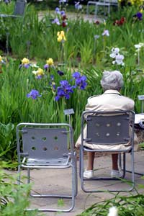
Psychosocial

Slide 42
Psychosocial
Disengagement
Systematically separated from society
Depression and withdrawal
Used to justify agism
“mutually beneficial” [sic]

Slide 43
Psychosocial
Activity theory
Mental and physical activity needed to thrive
Life course
Personality and personal adjustment through life
Erickson
Midlife crisis
Nursing implications

