Slide 1
VN057 Gerontology 7
10,11,12,13,14

Slide 2
Intelligence
Does not automatically decrease with aging
nor does the ability to learn
The elderly tend to be slower and more cautious in their responses
This does not indicate lack of intelligence
Lack of formal schooling may make older adults appear less intelligent
Notes:
Many older adults who grew up in difficult times ended their formal education at a young age because they had to work to help support their family.

Slide 3
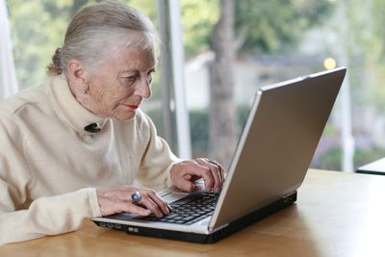

Slide 4
Memory Loss
Some degree of forgetfulness is common
People fear that they are “losing their minds” or developing serious problems
many older persons can compensate for memory gaps
relying more on the large pool of experience gathered over a lifetime
Notes:
There is no known reason why memory loss happens, but studies have shown that by 75 years of age, even an alert older person may lose as much as 30% of memory.
Can older people learn new information?

Slide 5
Delirium vs Dementia
Delirium
Usually sudden onset
Short time
“fixable”
Medication reaction
Infection [especially bladder]
B12 deffiency
Thyroid
Alcohol/drug withdrawl

Slide 6
Delirium vs Dementia
Dementia
Usually progresses slowly
insidious
Long term
Permanent and progressive
Many different types
Gradually worsens over time

Slide 7
Using Calming Touch
Notes:
See Figure 10-3 on p. 183.

Slide 8
Assessment for Disturbed Thought Processes
Does the person mention changes in memory?
Does the family notice memory changes?
Do they have problems remembering recent or remote events?
Can they grasp new ideas, or do they have difficulties?
Can they make appropriate, informed decisions?

Slide 9
Assessment for Disturbed Thought Processes (cont.)
What is the person’s dominant language?
Does the person speak other languages?
What is the person’s language/vocabulary level?
What is the person’s education level?
How long is the person’s attention span?

Slide 10
Assessment for Disturbed Thought Processes (cont.)
Are there significant behavior changes ?
Is the person restless, uncooperative, belligerent, angry, withdrawn, or threatening?
Have they had any delusions or hallucinations?
Are there any times of day when behavior is most noticeably different?
Do they have a history of stroke or other brain disease?

Slide 11
Assessment for Disturbed Thought Processes (cont.)
Have there been any recent changes in medication or dosage?
Are there any signs of infection?
What is the level of hydration?
Is the person constipated?
What is the person’s oxygen saturation?
What are the results of the Folstein Mini-Mental State Examination (MMSE)?

Slide 12
Pain Management
Pain can also be mistaken for dementia/delirium in the elderly.

Slide 13
Pain Scales
Notes:
See Figure 10-7 on p. 196.

Slide 14
Nursing Interventions for Pain
assess the nature and severity of the pain
Provide comfort measures
Avoid actions that increase pain
Anticipate situations likely to cause pain
Teach nonpharmacologic approaches to pain control
Administer medications as ordered

Slide 15
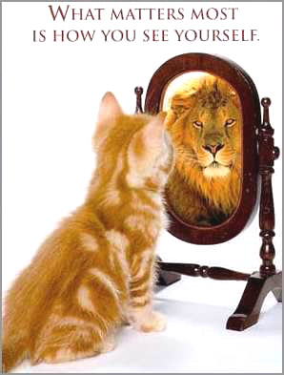
Chapter 11
Self-Perception
and Self-Concept

Slide 16
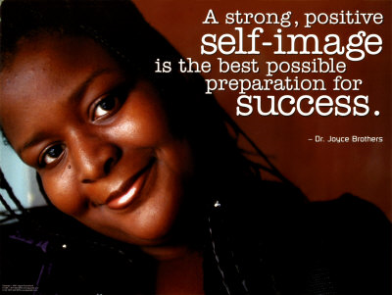
Normal Self-Perception and Self-Concept

Slide 17
Self-Identity
The attitudes & perceptions people have about themselves- abilities & self-worth
self-identity- values, life experiences & interactions with others

Slide 18
Self-Identity (cont.)
People with good self-worth and high self-esteem
Have strong personal values & believe that they have the ability to control their lives
Have had positive life experiences and have received positive feedback from others

Slide 19
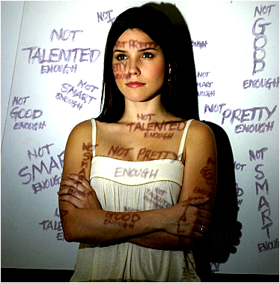
Self-Perception
Feedback from others affects our perception of ourselves

Slide 20
Self-Perception
People who feel able to control what happens in their life look at things far differently from those who don’t
Powerlessness
“victim”
Choices in activities of daily living are reflections of self-perception and level of self-esteem
“I can do it” vs “I can’t do it”

Slide 22
Self-Identity (cont.)
People with poor self-worth and low self-esteem tend to have
weak personal values
think that they have little control over their lives
primarily negative life experiences and have received negative feedback from others
Though this is not always the case
Notes:
Why do many people experience problems with self-worth?
In trying to meet external standards, people are likely to lose themselves and their internal values.

Slide 23
Self-Perception (cont.)
Problems related to self-perception and self-esteem are not as obvious as are physical problems
Notes:
What problems may loss of self control cause?
Our perceptions of self-worth and self-esteem are exhibited to others through behavior.

Slide 24
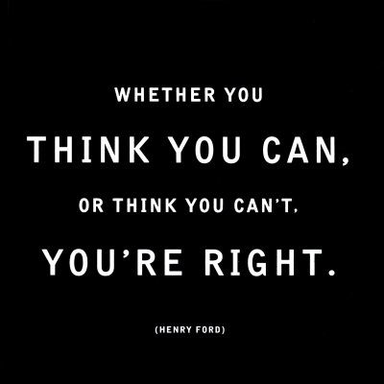

Slide 25
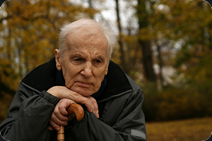
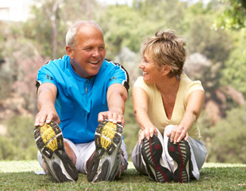
Self-Perception, Self-Concept, and Aging

Slide 26
Attitudes Toward Aging
individuals develop their own perceptions of aging
Many older adults are dismayed with the realization they’re growing older
can even identify a particular moment when they perceived themselves as old
Notes:
Successful aging has sometimes been described as “mind over matter”; if you don’t mind, it doesn’t matter.

Slide 27
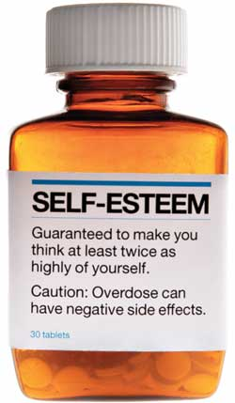
Successful aging
not so much a matter of years lived or health status, but rather a matter of perception and attitude

Slide 28
Self-Esteem Throughout Life
People c poor self-esteem all their lives don’t usually gain it with aging
People c healthy self-esteem when younger may have some problems as they age, but these are usually a result of societal attitudes
Notes:
What negative feelings may be seen in the older adult?
Studies have shown that the percentage of older adults experiencing problems appears to be no higher than among other age groups.

Slide 29
???
Successful aging has sometimes been described as:
ageism.
mind over matter.
great body image.
being over the hill.
Notes:
Answer: B

Slide 30
Extent of Physical Change
Many will do anything within their power to avoid s/s of aging
Hair dye, facial creams etc very common
Women- HRT
to maintain their sense of self-worth, some, w/enough money may try cosmetic surgery & hair transplants
The greater the of change, the more likely the person is to experience problems related to self-concept
Notes:
How does the youth-oriented society often portray the older adult?

Slide 31
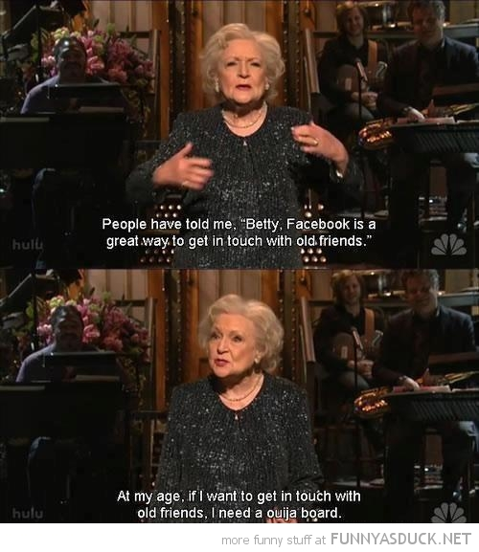

Slide 32
Emotional Support Systems
Loss of loved ones
more damaging than loss of physical and functional abilities
The friends & loved ones who made life worthwhile slip away, one by one
positive messages that a person is worthwhile, lovable, and loved become less frequent, and the reasons for living disappear

Slide 33
Emotional Support Systems (cont.)
Older adults who are separated from their families and significant others are at increased risk for experiencing diminished self-worth as well as depression
Notes:
How may institutional placement be damaging to self-worth?
We cannot prevent loss resulting from death, but loss resulting from separation is another matter.
If family and friends visit often and show positive concern, self-esteem can be maintained.

Slide 34
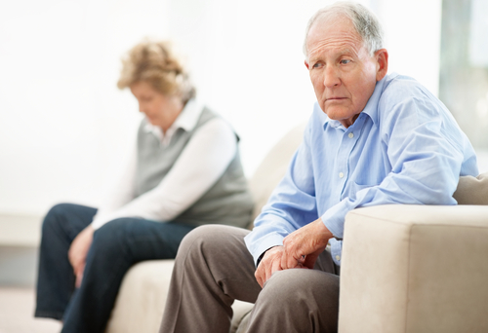

Slide 35
Depression and Aging
Difficult to recognize
signs are similar to many medical disorders or medication side effects
Related to multiple factors
loss of independence
Loss of friends & loved ones
increased medical problems
use of medications to treat disease
Med s/e
Sheer number of medications often referred to as “depressing”
Notes:
It is estimated that among people over age 65, depression is a problem for as many as 1% to 9% of community-dwelling older adults, 10% to 26% of long-term care residents, and 22% to 46% of hospitalized older adults.
What medications are associated with an increased incidence of depression?

Slide 36
Changes That Warrant Further Investigation
Stopping normal routines
Neglected self-care
Unwillingness to talk
Agitation and irritability
Suspiciousness or unjustified fears
Mood swings

Slide 37
Depression cont….
Many similarities in symptoms
Depression vs dementia
Depression vs B12 defficiency
Depression vs dementia vs med s/e
Depression vs illness vs dementia
[especially infection-UTI]

Slide 38
Changes That Warrant Further Investigation (cont.)
Isolation and withdrawal
Increased use of alcohol or mood-altering drugs
Unexplained injuries
Verbalization of worthlessness
Verbalization of suicidal thoughts

Slide 39
Suicide and Aging
risk for suicide because of depression, severe emotional/physical pain, a recent loss, stressful event, or terminal illness
have often presented to health care providers with various physical complaints
Depression/anxiety often have physical manifestations
Insomnia, GI disturbances, fibromyalgia etc
highest rate of successful suicides compared to other age groups
Notes:
Older adults make up about 12% of the total U.S. population, but they account for 17% of the suicides.
What population is most likely to commit suicide?
Family members and health care professionals can help by being aware of warning signs and risk factors.

Slide 40
Nursing Process for Disturbed Self-Perception and Self-Concept
When an older adult has a poor self-concept, fears and anxieties increase
As control over one’s life decreases, self-esteem plummets even lower
feelings of hopelessness and powerlessness
lead to depression
Depression leads to isolation from others, further decreasing the sense of self-worth

Slide 41
Nursing Process for Disturbed Body Image
People experiencing body image disturbance are likely to refuse to look at or touch the affected body parts
Ostomy
Mastectomy
Aging in general; incontinence
In severe disturbances- may deny change has occurred & act as though nothing happened
may verbalize feelings of worthlessness and powerlessness

Slide 42
Nursing Interventions for Situational Low Self-Esteem
Explore feelings & concerns
Demonstrate acceptance of older adults as people with value and self-worth
Encourage participation in self-care
Provide opportunities for reminiscence
Encourage family to participate in reminiscence
Provide pictures or items that bring back memories of happy times
Encourage families to communicate positive feelings to the older person

Slide 43
Active Participation in Care
Notes:
See Figure 11-1 on p. 206.

Slide 44
Reminiscing
Notes:
See Figure 11-2 on p. 207.

Slide 45
Self-Esteem in Aging
Notes:
See Figure 11-3 on p. 207.

Slide 46
Nursing Process for Fear
Fear=feeling of dread or apprehension regarding an identified source
student fear….comprehensive final
common fears in older adults
disruption in lives or routines
Crime and victimization
Loss of loved ones
Disease, injury, pain and suffering
Loss of independence
Financial destitution
Loneliness

Slide 47
Nursing Interventions for Fear
Provide opportunities to express
Remove or reduce the most common sources
Provide explanations for all care procedures
Encourage verbalization of thoughts & feelings
quiet environment & reduce excessive stimulation
Provide distraction or diversion

Slide 48
Crafts
Notes:
See Figure 11-4 on p. 209.

Slide 49
Other clinical manifestations of powerlessness
Attempt to control environment…
Needy
Attention seeking
Multiple demands
Refuse care
Changing mind/conflicting demands

Slide 50
Nursing Process for Powerlessness
Powerlessness-People feel they have lost control of what happens to them
results from the loss of control of physical functions or body parts or from loss of a body part
Powerlessness-common with hospitalization or placement in an extended-care facility

Slide 51
Nursing Interventions for Powerlessness
Allow to make choices when possible
Encourage older adults to do as much as possible for themselves
Adapt environment to encourage independence
Explain reasons for changes in the plan of care
Avoid being overprotective or directive
Respect older adults’ right to refuse

Slide 52
Assertiveness vs aggressiveness
Notes:
See Figure 11-5 on p. 211.

Slide 53
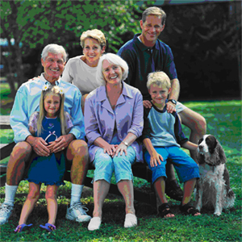
Chapter 12
Roles and Relationships

Slide 54
Normal Roles and Relationships

Slide 55
Role
socially accepted behavior pattern
People tend to establish their identities & describe themselves based on the roles they play in life
Adult, senior citizen
Man, woman, husband, wife
Parent, child, son, daughter
Student, teacher, doctor, nurse, mechanic, housewife

Slide 56
Role (cont.)
many roles over a lifetime
often must attempt to play several roles simultaneously
identified, defined, & given value by the society in which a person lives
Notes:
Behaviors, symbols, and relationship patterns can differ widely, depending on the values and norms of the society in which the individual lives.
What does the value assigned by society indicate?

Slide 57
Relationships
Connections formed by interaction of individuals who play interrelated roles
Parent & child
Employer & employee
The way individuals in each role interact describes their relationship
Student & teacher
Can be short- or long-term, personal or impersonal, intimate or superficial
Change over time & are affected by role changes of the people involved

Slide 58
Homogeneous Society
all members share a common historical and cultural experience
Everyone knows the rules and everyone plays by the same rules
If you don’t-everyone also agrees that you aren’t playing by the rules
little confusion or conflict
symbols, behaviors & relationships are perceived in the same way by all members of the society
Everyone knows the accepted roles and how people in each role are expected to relate to each other

Slide 59
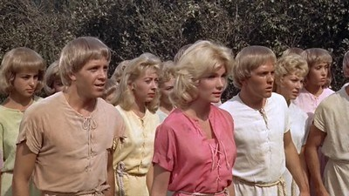
Homogenous

Slide 60
Heterogeneous Society
members of many diverse subcultures with different historical and cultural experiences must interact
subcultures may have their origin in race, religion, ethnic heritage, or age
There are rules, there are different sets of rules, not everyone knows the rules
Not everyone knows when someone’s not playing by the rules, nor does everyone agree that they are or aren’t
Roles and role expectations not always clear
lack of shared perceptions often leads to misunderstandings, confusion, and conflict
Notes:
Is the American culture a homogeneous or heterogeneous society?
Because people form their self-image based on their roles and relationships, they are likely to have difficulty accepting changes in either.

Slide 61
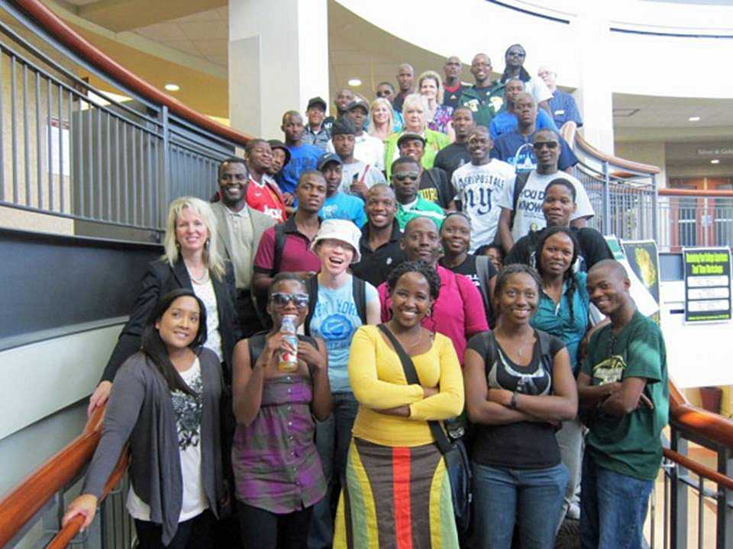
hetrogenous

Slide 62
…….France…..
Was homogeneous
Almost entirely French people
Birth rate constant
Minimal generational conflict
Social service entitlements [mostly] worked
Now-[semi]suddenly heterogeneous
Large influx of non-French people/culture/religion
Not everyone is playing by the same rules
Unfamiliar to origin culture-causes conflict
Extremely high birth rate of new immigrants
Generational & cultural conflicts
Entitlements no longer sustainable

Slide 63
Roles, Relationships, and Aging

Slide 64
Older Adults
adjust to many age related role & relationship changes
Retirement
Altered relationships with adult children
housing
Loss of valued possessions & friends because of relocation or death
Loss of spouse to death
Loss of health and/or independence

Slide 65
Older Adults (cont.)
May resent forced retirement
May resent need to continue working
The more roles and relationships a person develops when young, the better the ability to adjust when some roles and/or relationships are lost

Slide 66
Retirement
To maintain part of the role + connection with working people, many retired older adults continue to think of themselves as a part of their occupation
There are some roles from which a person cannot officially “retire”
Notes:
What are examples of roles from which a person cannot officially retire?

Slide 67
Parenting
Older adults do not give up the role of parent just because their children are adults
Role conflict and altered family relationships
Common when older adults attempt to direct their children’s behavior long after the children are adults
Notes:
Successful adjustment to changes in the parenting role is difficult and requires a great deal of patience, tact, and accommodation on the part of all family members.
Which families are likely to have the most serious problems with adjusting to role changes?

Slide 68
Grandparenting
role of grandparent
often described as being much more fun than being a parent
Allows older adults to share their wisdom and experiences with a new generation
grandparents often under less daily stress & are not the primary disciplinarians-
usually more relaxed
more time to spend on nonessential activities, such as conversation and play
Notes:
It is common for retired grandparents with time on their hands to entertain children with stories or teach them skills, hobbies, or games that the grandparents learned as children.

Slide 69
Grandparenting (cont.)
Notes:
See Figure 12-1 on p. 217.

Slide 70
Grandchildren
Notes:
See Figure 12-2 on p. 217.

Slide 71
Spouse/marriage
Many have been married for 30, 40, 50 or more years
successful long-term marriage requires a great deal of effort
loss of this relationship triggers EXTREMELY high levels of emotional distress
Grief can be so overwhelming surviving spouse can’t continue to perform normal ADL’s
Widow-surviving wife
Widower-surviving husband

Slide 72
Friends
loss of friends-changed roles & relationships
Death
disability
relocation
Older persons who outlive their families and friends often feel that their lives are without purpose
Notes:
Why may social isolation occur in the older adult?

Slide 73
Housing
Many change housing arrangements
Choice
Necessity
smaller
sale or distribution of personal possessions accumulated over a lifetime
Notes:
Loss of possessions makes the process of moving even more traumatic for older adults. In some ways, they are “giving away” their lives.

Slide 74
Health and Independence
lose health and independence
lose control over their own destiny
at the mercy of others (either family or strangers) for care and sustenance

Slide 75
Nursing Process for Social Isolation and Impaired Social Interaction
Social isolation, the sense of being alone, is common
result of many factors and can be unintentional or intentional
The more people are separated from family and friends, the greater the likelihood of social isolation will be

Slide 76
Maintaining Social Contact
Notes:
See Figure 12-3 on p. 220.

Slide 77
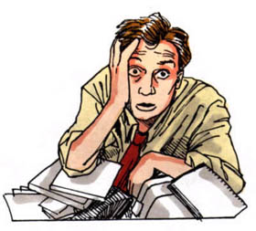
Chapter 13
Coping and Stress

Slide 79
Normal Stress and Coping

Slide 80
Physical Signs of Stress
“Fight or Flight”
Cardiovascular signs
heart rate and amount of blood ejected from the heart during each contraction increase
Respiratory signs
rate increases & bronchial passages dilate during stress to allow increased oxygen exchange
Musculoskeletal signs
Muscle tension in the back, neck, and head increases with stress

Slide 81
Physical Signs of Stress (cont.)
Gastrointestinal signs
Peristalsis & production of digestive enzymes decrease
Urinary signs
Decreased urine production but increased frequency
Cognitive signs
Mild stress-increased state of alertness
Severe stress affects problem-solving ability
“frozen”

Slide 82
Physical Signs of Stress (cont.)
Emotional signs
Fatigue, tension, anxiety
Severe stress- people may have signs of clinical depression or even verbalize suicidal thoughts
Behavioral signs
Some avoid all interactions or tasks that might increase their stress level
some take on additional duties in an attempt to block out or distract themselves from the source of their distress
Notes:
Is depression a normal part of aging?
Depression is also likely to occur when older adults perceive that they have lost control of a situation, that they lack the support of significant others, or that their normal coping mechanisms have been overwhelmed by the number or severity of stressors.

Slide 83
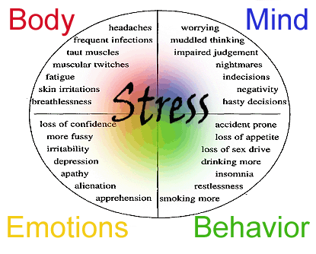

Slide 84
DSM-IV-TR Symptoms of Depression
Changes in appetite & weight- < or >
Disturbed sleep - < or >
Motor agitation or retardation
Fatigue and loss of energy
Depressed or irritable mood
Loss of interest or pleasure in usual activities
Feelings of worthlessness, self-reproach, guilt
Suicidal thinking or attempts
Difficulty with thinking or concentration
Notes:
Refer to Box 13-1 on p. 226.

Slide 85
Stress and Illness
both mental and physical illness cause stress & stress increases the risk for both mental and physical illness
Decreasing stressors or level of stress can prevent illness or improve a person’s ability to cope with existing illnesses
Stress has been shown to have negative effects on many body systems
Notes:
Those who do not learn to cope effectively with normal day-to-day stressors cannot function normally when the stress level is high and thus are at risk for becoming physically or mentally ill.
Those who do learn good coping strategies can maintain their ability to function, despite high-level stress.

Slide 86
Stress and Illness (cont.)
Coping mechanisms are neither good nor bad
become dysfunctional when used excessively or inappropriately as a way of avoiding dealing with the stressors
Many different coping or defense mechanisms are used as part of day-to-day living

Slide 87
Substance Abuse
Notes:
See Figure 13-1 on p. 229.

Slide 88
Stress and Life Events
Although stress can cause physical illness, physical illness’ also increases stress
can increase due to loss—
friends, family members & particularly a spouse
change in residence or financial worries, can also contribute to stress

Slide 89
Stress Reduction and Coping Strategies
Problem-focused coping strategies
Attempt to change or eliminate the stressful event or threat
Very difficult because people often get “tunnel vision” and can only “see” their stressor and feel trapped-can’t see a way out. [self effacacy]
Emotion-focused strategies
Attempt to change the person’s response to the stressful event or threat
One effective way of reducing stress is to avoid or escape the stressor(s)

Slide 90
Stress Reduction and Coping Strategies (cont.)
When stressors cannot be avoided, when their personal significance is high, or when the person believes he or she can affect the outcome, other methods can be used
Confrontational methods
Cognitive methods
Problem-solving methods
Notes:
What relaxation techniques may be used to cope with stress?

Slide 91
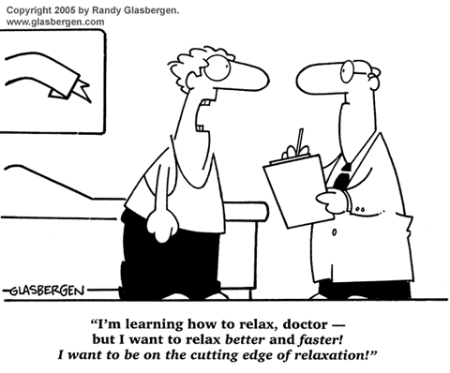

Slide 92
Nursing Process for Relocation Stress Syndrome

Slide 94
Nursing Goals/Outcomes
Recognize the reasons for the move or change
Find ways to maintain control & decision-making in the new environment
Verbalize concerns about new living arrangements
Identify methods for coping with change

Slide 95
Chapter 14
Values and Beliefs

Slide 96
Values and Beliefs
Originates c individual’s religion, philosophy, family, culture & society
Affect all aspects of life
important role in promoting health and coping with illness
most values well-established by 10 years old
Sub-generation dependent
Sub generation=increments of a generation
Boomers-very different experiences
Grew up in 50’s
Grew up in 60’s
Grew up in 70’s
Notes:
Because people develop their values based on a unique combination of time, place, and experiences, no two people have the exact same beliefs and values.
How may a person’s values differ according to when they were born?
What is the most effective way to change beliefs and values?

Slide 97
Values and Beliefs (cont.)
Values & beliefs-the glasses through which you see the world
filter used to judge other people and events
Misunderstanding & conflict occur when people with two different or contradictory sets of values interact
Democrat vs Republican vs Libertarian vs Green….

Slide 98
Common Values and Beliefs of Older Adults

Slide 99
Economic Values
Many strongly affected by the Depression of the 1930s
taught the value of a dollar and to “waste not, want not”
Frugal
Not consumer driven
GREW UP BEFORE CREDIT CARDS…..
Pre pension, pre social security
feel shame if forced to accept charity
Many even considered social security charity
Notes:
Financial independence is important to these individuals.
Why may they refuse to buy medications?

Slide 100
Economic Values (cont.)
May save or hoard- even items that present health hazards
value saving rather than wasting
store excessive number of personal belongings
Clutter- safety hazard
refuse to see a doctor or wait until seriously ill
concerned about the cost
Grew up without insurance, paid cash for med care
Limited savings

Slide 101
Intrapersonal Values
value respect and obedience
Can’t understand why their families do not automatically accept what they say & follow directions
The more divergent the values of various family members, the more likely there are to be misunderstandings and conflict

Slide 102
Cultural Values
Shared cultural values define authority structure
establish norms for language and communication
establish a basis for decision making and lifestyle choices
A heterogeneity of cultures creates a vibrant and dynamic society, but also creates many opportunities for prejudice and misunderstanding

Slide 103
Cultural Values (cont.)
Many older adults have lived in this country for years but still identify more with their ethnic group or country of origin than with the dominant society
Notes:
Why have some sociologists defined America as a “fruit salad” rather than as a “melting pot?”
New immigrants experience a period of “culture shock” when entering a new cultural environment in which their traditional values and practices differ from those of the dominant culture.

Slide 104
Spiritual or Religious Values
Spirituality-
relationship between the person and something greater [higher power]
These beliefs give meaning to life and to all the positive and negative experiences that occur during a lifetime

Slide 105
Spiritual or Religious Values (cont.)
Many of today’s older adults were raised in an organized religion that played an important role in the formulation of their values and beliefs
Notes:
What emotions may be inspired by spirituality?
Decisions regarding the end of life, including the use of high-technology interventions, living wills, euthanasia, or physician-assisted suicide, are usually based on religious beliefs and value systems.

Slide 106
Notes:
See Figure 14-1 on p. 238.

Slide 107
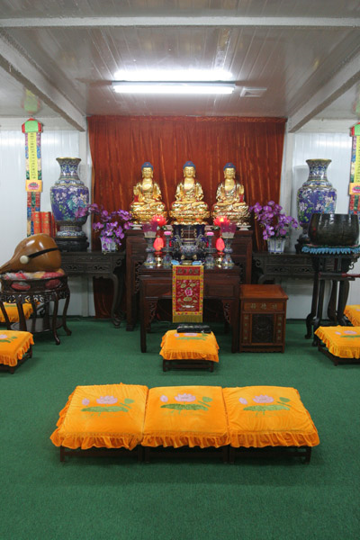

Slide 108
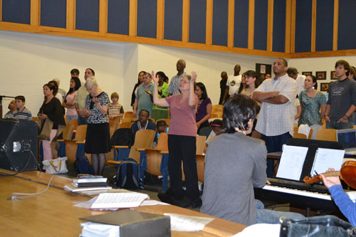

Slide 109
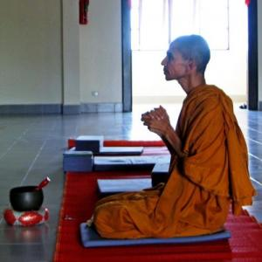

Slide 110
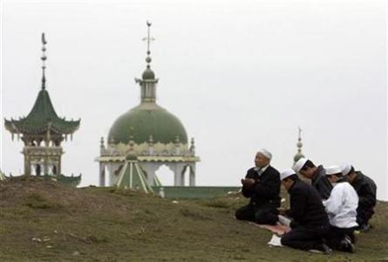

Slide 112
Nursing Process for Spiritual Distress

Slide 113
Assessment
What is the person’s cultural background?
Do they have any specific cultural or religious beliefs related to health?
Is religion a significant factor in the person’s life?
Do they attend religious services regularly?
What is the person’s religious denomination, sect, church, etc.?

Slide 114
Nursing Interventions
Determine whether there are special spiritual practices and/or restrictions
Identify significant persons who provide spiritual support
Determine whether there is any way that nurses can aid older adults in meeting their spiritual needs
Provide opportunities for the person to express spiritual needs and concerns

