Slide 1
VN057 Gerontology 11

Slide 2
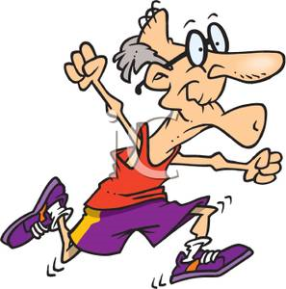
Chapter 19
Activity and Exercise

Slide 3
Normal Activity Patterns
Behaviors related to exercise, activity, leisure, and recreation
Activity-anything that requires the expenditure of energy
Amount & type changes over the life span but remains a vital part of life
Activity is necessary to maintain normal joint mobility and muscle tone
Notes:
Physical activity requires a complex interaction of physiologic processes, primarily those of the neurologic, musculoskeletal, cardiovascular, and respiratory systems.
Why are the nervous and musculoskeletal systems of particular importance related to activity?

Slide 4
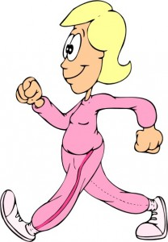

Slide 5
Activity and Aging

Slide 6
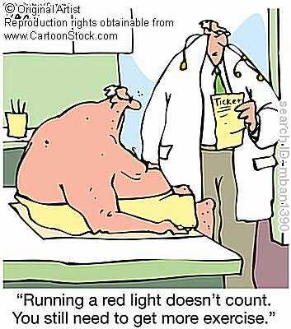

Slide 7
Changes in the Ability to Perform or Tolerate Activity
The speed of nerve transmission slows
Loss of muscle mass
Loss of cushioning cartilage
Agility-the ability to move quickly and smoothly, decreases with age
Notes:
In general, the more active a person has been, the more active he or she remains with aging.
How does a decrease in oxygen exchange affect activity?

Slide 8
Changes in the Ability to Perform or Tolerate Activity (cont.)
Dexterity, the ability to perform fine manipulative skills decreases with age
Decreased stamina
Coordination of multiple activities decreases with aging

Slide 9
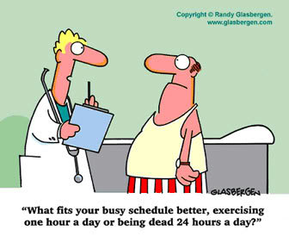

Slide 10
Exercise and Recommendations for Older Adults
Evidence indicates regular activity can extend years of active independent life, reduce disability & improve the quality of life
Aerobic or endurance exercises promote cardiovascular and respiratory function
Notes:
What are current recommendations regarding the length and type of exercise for the older adult?
Before starting an exercise program, the older person should know the importance of acquiring good supportive footwear and clothing appropriate for the environment and type of exercise.

Slide 11
Exercise and Recommendations for Older Adults (cont.)
Nurses should educate older persons about the importance of exercise
Emphasize the benefits
Weight loss
Improved blood glucose control
Lowered blood pressure
Decreased risk for falls
Others specific to the individual

Slide 12
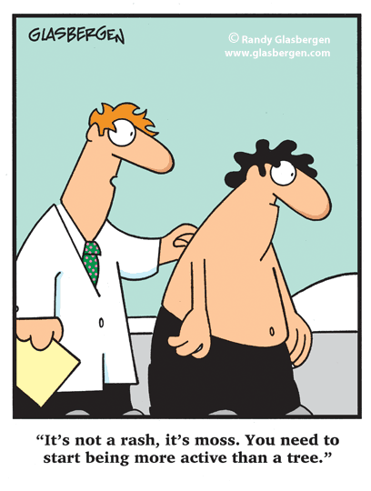

Slide 13
Guidelines for Exercise by the Older Adult
Keep it simple
Have a plan
Do it with a friend
Keep it interesting
Try some music
Get a coach
Set a goal
Notes:
Focusing on the positive outcomes of exercise is key to maintaining a regular program.

Slide 14
Various Exercises
Notes:
See Figure 19-1 on pp. 308-309.

Slide 15
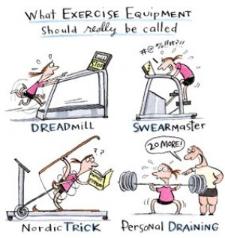

Slide 16
Effects of Disease Processes on Activity

Slide 17
Organic Brain Syndrome, Alzheimer’s Disease, and Stroke
Affects both high-level thinking & motor function
Persons may not recognize the need for the most basic activities, such as moving, eating, dressing, bathing, and toileting

Slide 18
Neurologic Damage
Individual may recognize the need & have the desire to perform an activity but be unable to carry out the activity
The nervous system does not transmit appropriate messages to the muscles to enable them to perform the activity
Notes:
Abnormal nerve transmission can result in difficulty getting started with movement or uncoordinated muscle activity.

Slide 19
Diseases or Injury to the Musculoskeletal System
Fractures-lead to mobility restriction, depending on the part(s) of the body affected
Gout or arthritis-person avoids use of the painful joints to reduce discomfort
DJD severely restricts mobility, particularly in the weight-bearing joints in the knees and hips
Notes:
Fracture of a large bone such as the femur results in severe limitation of mobility.
While waiting for healing to occur, strength and joint mobility can be lost if preventive nursing interventions are not instituted.

Slide 20
Foot Conditions
Bunions, hammertoes, and calluses
May interfere with ambulation, particularly if footwear does not fit properly
Painful feet are a common reason for decreased activity in older adults

Slide 21
Conditions that Interfere with Intake or Distribution of Oxygen
Diseases of the respiratory system-inadequate O2 intake/exchange in the lungs (e.g., asthma, emphysema, bronchitis, pneumonia)
Diseases of the cardiovascular system-pump malfunction prevents distribution of oxygen to body tissues & heart (e.g., myocardial infarction, congestive heart failure, heart block, arteriosclerosis, hypertension)
Notes:
Inadequate oxygenation places additional stress on the cardiovascular and respiratory systems.
Pulse and respiratory rates increase in an attempt to compensate for the decreased amount of oxygen.
What is intermittent claudication?

Slide 22
Malnourishment
Lack of adequate protein to build muscle, adequate supply of glucose to fuel muscles, and adequate iron to form hemoglobin [provides oxygen to the muscles]
Notes:
How can inadequate iron intake affect activity of the older adult?

Slide 23
Emotional Disorders
Individuals may be directing all their energy inward and may not be willing or able to summon the energy required for physical activity
need to continue to use their bodies to prevent loss of physical function
Increased depression
Increased anxiety

Slide 24
Nursing Process for Impaired Physical Mobility

Slide 25
Assessment
contractures or deformities?
pain or tenderness in the joints?
particular motion that aggravates joint pain?
What relieves discomfort?
How is the muscle tone of the arms and legs?
Is muscle strength equal on both sides of the body?

Slide 26
Assessment (cont.)
muscle tenderness?
Is the person bedridden, wheelchair-bound, or ambulatory?
If ambulatory, what is the pattern of the gait?
Steady? Ataxic? Slow? Rapid?
able to lift his or her feet when walking, or does the person shuffle?
Does the person maintain an upright posture when walking?

Slide 27
Assessment (cont.)
Do both sides of the body move evenly?
How well can the person maintain balance?
What kind of footwear does the person wear for walking?
Does the person have any foot problems (e.g., bunions or calluses) that interfere with walking?
How far can the person ambulate without discomfort? Being too weak/tired to continue?

Slide 28
Assessment (cont.)
any assistive devices (walkers or canes) for ambulation?
Does the person know how to use these assistive devices properly?
Does the person feel comfortable and confident using these aids?
Does the person require the assistance of another person to ambulate?

Slide 29
Assessment (cont.)
If not ambulatory, what is their activity level?
wheelchair?
Can they operate the wheelchair themselves?
Does the person receive passive range-of-motion exercises?
Is the environment safe for the individual?

Slide 30
Nursing Diagnosis
Impaired physical mobility

Slide 31
Nursing Goals/Outcomes
Increase participation in physical activities that maintain strength and mobility
Maintain normal anatomic position and function in all joints
Remain free from joint contractures and foot drop
Maintain or increase strength and mobility using assistive devices

Slide 32
Nursing Interventions
Identify the prescribed activity level
Continue to assess strength and joint mobility
Perform physical mobility activities in conjunction with daily care
Provide good body alignment and frequent position changes
Avoid unnecessary restraint that limits physical mobility

Slide 33
Nursing Interventions (cont.)
Consult with physical therapist for exercise plan that maintains muscle strength and joint mobility
suitably dressed for activity and has the proper footwear
Provide pain medication in a timely manner

Slide 34
Trapeze Bar
Notes:
See Figure 19-2 on p. 310.

Slide 35
Quad Cane
Notes:
See Figure 19-3 on p. 310.

Slide 36
Walker
Notes:
See Figure 19-4 on p. 310.

Slide 37
Gait Belt
Notes:
See Figure 19-5 on p. 311.

Slide 38
Nursing Process for Activity Intolerance

Slide 39
Assessment
Does the person complain of shortness of breath, fatigue, or weakness?
How much exertion can the person tolerate before shortness of breath or fatigue is noticed?
Has participation in routine activities decreased?
Does the person complain of decreased interest in activities?

Slide 40
Assessment (cont.)
pulse rate and blood pressure?
Do vital signs remain within normal limits with activity?
orthostatic hypotension?
Is the person’s nutritional intake adequate?

Slide 41
Nursing Diagnosis
Activity intolerance

Slide 42
Nursing Goals/Outcomes
Demonstrate an increased ability to tolerate activity
Identify factors that contribute to activity intolerance

Slide 43
Nursing Interventions
Identify factors that contribute to activity intolerance
Identify the activities they view as essential or desirable

Slide 44
Nursing Interventions (cont.)
pace activities- alternating periods of activity with periods of rest
Monitor vital signs to assess the physical responses
Teach methods of conserving energy
Teach methods of reducing stress

Slide 45
Nursing Process for Problems of Oxygenation

Slide 46
Assessment
Does the person experience excessive fatigue?
What level of activity causes this fatigue?
complaints of nausea, vomiting, or anorexia?
Does the person complain of dyspnea?
worse at any specific time of day, such as during the night? [orthopnea]

Slide 47
Assessment (cont.)
chest pain?
tachycardia?
What is the person’s respiratory rate?
Is the person’s breathing silent and effortless? If not, describe.
Does the person’s chest expand evenly with respiration?
Is breathing deep or shallow?

Slide 48
Assessment (cont.)
Does the person adopt a posture that is more comfortable for breathing?
cough? If so, is the cough productive?
Sputum appearance?
order for supplemental oxygen?
history of exposure to air pollution, smoking, mining, farming, asbestos?

Slide 49
Assessment (cont.)
signs of cyanosis present? Cold, clammy skin? Diaphoresis?
Are the jugular veins distended? At what angle (30 degrees, 45 degrees)?
Are the peripheral pulses palpable? Are pulses equal on both sides of the body?

Slide 50
Assessment (cont.)
What color are the nail beds and fingers?
capillary refill time?
normal amount of body hair over the feet and lower legs?
any leg pain with ambulation?
how severe is the pain? Is it relieved by rest?
Does the person complain of cold hands and feet?

Slide 51
Assessment (cont.)
peripheral edema present?
urinary output low despite normal fluid intake?
rapid weight gain of more than 10 pounds?
signs of confusion?
anxiety, loss of ability to concentrate, or insomnia?

Slide 52
Assessment (cont.)
Are there any changes in relevant laboratory values (e.g., hemoglobin, hematocrit, cardiac enzymes, electrolytes)?
If an electrocardiogram was done, are there any changes?
If chest x-ray done, any signs of heart enlargement or congestion?

Slide 53
Nursing Diagnoses
Decreased cardiac output
Impaired gas exchange
Ineffective airway clearance
Ineffective breathing pattern

Slide 54
Nursing Goals/Outcomes
Maintain an open, patent airway
Experience fewer episodes of dyspnea, angina, and cyanosis
Demonstrate an increased ability to tolerate activity
Identify methods to reduce physical and psychological stress

Slide 55
Nursing Interventions
Assess pulse and respiration before, during, and after activity
Monitor laboratory values, x-ray reports, and results of other diagnostic studies
Observe respiratory effort, including the use of accessory muscles
Evaluate oxygenation by observing for signs of cyanosis, pulse ox and by checking capillary refill time

Slide 56
Nursing Interventions (cont.)
Assess peripheral pulses, particularly in the lower extremities
Position to maximize chest expansion and encourage frequent changes of position
Clear secretions and teach effective coughing
Administer medication as ordered to promote cardiovascular and respiratory function
Administer supplemental oxygen as ordered
Use spirometers to improve ventilation

Slide 57
Nasal Cannula
Notes:
See Figure 19-7 on p. 316.

Slide 58
Portable Oxygen Cylinder
Notes:
See Figure 19-8 on p. 317.

Slide 59
Nursing Process for Self-Care Deficits

Slide 60
Assessment
Can the person feed himself or herself? If not, what level of assistance is required (0-4)?
0 = Completely independent
1 = Requires devices or equipment
2 = Requires help, supervision, or teaching from another person
3 = Requires devices and help from another person
4 = Totally dependent

Slide 61
Assessment (cont.)
Can the person toilet himself or herself? If not, what level of assistance is required (0-4)?
Can the person bathe himself or herself? If not, what level of assistance is required (0-4)?
Can the person dress himself or herself? If not, what level of assistance is required (0-4)?

Slide 62
Nursing Diagnoses
Feeding self-care deficit
Bathing/hygiene self-care deficit
Dressing/grooming self-care deficit
Toileting self-care deficit

Slide 63
Nursing Goals/Outcomes
Perform self-care at the highest possible level within limitations
Demonstrate the use of modified techniques and assistive devices to accomplish self-care
Verbalize improved self-esteem related to self-care abilities
Identify resources that are available to provide assistance

Slide 64
Devices to Assist with ADLs
Notes:
See Figure 19-9 on p. 320.

Slide 65
Devices to Assist with Self-Care
Notes:
See Figure 19-10 on p. 321.

Slide 66
Modified Eating Utensil
Notes:
See Figure 19-11 on p. 321.

Slide 67
Bathtub with Grab Bars
Notes:
See Figure 19-12 on p. 321.

Slide 68
Negative Attitudes: The Controlling or Custodial Focus
Nurses who take a negative view of aging see it as a process of deterioration and loss
see little potential for improvement
Maintenance of function is supported, but no improvement or higher level of functioning is expected or encouraged

Slide 69
Negative Attitudes: The Controlling or Custodial Focus (cont.)
Care plan is often limited to physiologic and safety concerns
Negative attitudes that older adults themselves have may lead to declining function

Slide 70
Positive Attitudes: The Rehabilitative Focus
Nurses who have a positive attitude toward aging recognize that most older people have a great deal of unused and often unrecognized potential
A rehabilitative care focus addresses both the actual and potential problems that older adults are likely to experience
Notes:
What is a proactive approach to nursing care planning?

Slide 71
Positive Attitudes: The Rehabilitative Focus (cont.)
To plan care with a rehabilitative focus, nurses must do the following
Individuals have intrinsic worth that exceeds their limitations
Accept that older adults have the right to make informed decisions regarding their care
Notes:
What is the long-term goal of rehabilitative nursing care?
When planning care with a rehabilitative focus, nurses look beyond the nursing interventions and act as coordinators for all the various disciplines that enable the older adult to achieve his or her highest level of physical, mental, psychosocial, and spiritual functioning.

Slide 72
Positive Attitudes: The Rehabilitative Focus (cont.)
To plan care with a rehabilitative focus, nurses must do the following (cont.)
Recognize loss of function has a serious impact on individuals, their families & significant other(s)
Recognize that the client, their families, and significant other(s) are important members of the health team and that all should play a role in decision making whenever possible

Slide 73
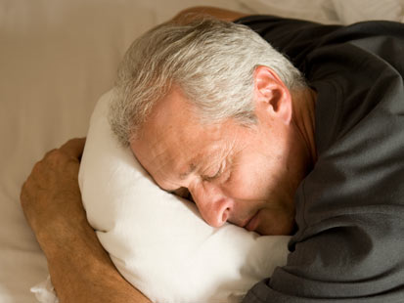
Chapter 20
Sleep and Rest

Slide 74
Sleep-Rest Health Patterns
sleep, rest & relaxation during a 24-hour day
Individual perceptions, rituals, and aids used to promote sleep and rest
Sleep allows the body time to rejuvenate and respond to the stresses of daily living
Notes:
No one knows exactly why we sleep, but it is a fact that we all require sleep to function normally.
What issues may be connected to sleep deprivation and insomnia?
It is estimated that as many as half of all independent-living older adults and two-thirds of institutionalized older adults have sleep disturbances.

Slide 75
Normal Sleep and Rest
pattern that repeats approximately every 24 hours
individuals unique patterns for waking and sleeping
Circadian or diurnal rhythm
The 24-hour cycle occurs in response to the day-night cycle of the sun
ICU psychosis…..
Notes:
Sleep is not a uniform state of unconsciousness; rather, it is divided into a series of cycles of lighter and deeper stages of sleep.
How do levels of cortisol and growth hormone affect sleep?

Slide 76
Normal Sleep and Rest (cont.)
Sleep controlled by release of serotonin in the brainstem
Melatonin, produced by the pineal gland, is released when the level of light decreases

Slide 77
The Adult Sleep Cycle
Presleep
A stage of increased relaxation and drowsiness that typically lasts from 10 to 30 minutes
About an hour into a lecture…..

Slide 78
The Adult Sleep Cycle (cont.)
Non-REM stages and REM stages
Four to six complete sleep cycles-between 1 and 2 hours each
Cycle=4 non–REM stages & 1 REM stage
As the night’s sleep progresses, REM gets longer & non-REM periods are shorter
If sleep is interrupted- the individual goes back to stage 1 of non-REM sleep and begins a new cycle
Nocturia
Staff disruptions
Room mates; household noise

Slide 79
The Adult Sleep Cycle (cont.)
Notes:
See Figure 20-1 on p. 329.

Slide 80
Sleep and Aging
Levels of sleep hormones change
Decreases in melatonin & growth hormone= shifting in circadian rhythm
sleepy earlier in the evening & awake earlier in the morning.

Slide 81
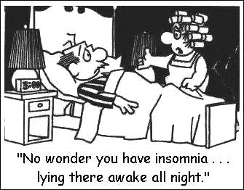
Insomnia
Difficulty falling asleep or remaining asleep
Also- the feeling that you’re not getting enough sleep
Notes:
Older individuals with existing health problems are more likely to experience sleep problems than those who report themselves to be in good health.
What medical conditions may be related to having insomnia?

Slide 82
Types of Insomnia
Sleep initiation problems
Can’t fall asleep
Sleep maintenance problems
Can’t stay asleep
Terminal insomnia
Sleeping for only a few hours-
emotional stress, pain or physical illness.

Slide 83
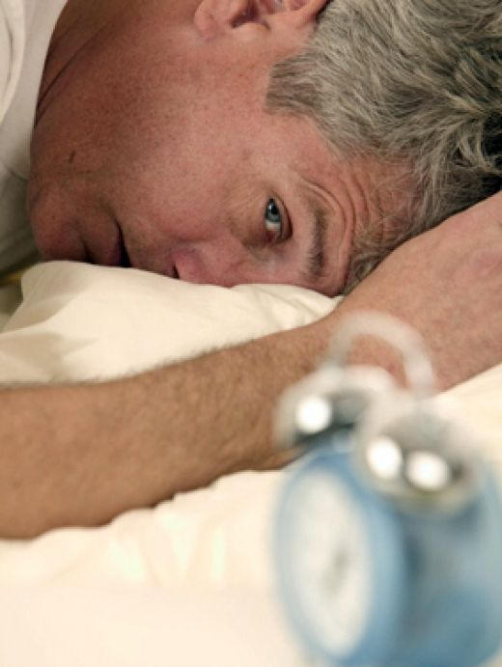

Slide 84
Medications Used to Promote Sleep
Sedative/hypnotics—GABA receptor agents
Benzodiazepines
Antihistamines
Some classes of Antidepressants
Chloral hydrate
Barbiturates
Neuroleptics
Herbs
Notes:
Refer to Table 20-1 on p. 330.

Slide 85
Drugs that Contribute to Sleep Disorders
Caffeine
Alcohol
Xanthine derivatives
Decongestants
Hormones
Diuretics
Neuroleptics
Nicotine
Some classes of Antidepressants
Antihypertensives
Antineoplastics
Anticholinergics
Antihistamines
Benzodiazepines
Nicotine replacement products
Notes:
Refer to Box 20-2 on p. 331.

Slide 86
Risk Factors Related to Sleep or Rest Problems
Pain
respiratory or cardiovascular problems
Frequent elimination
Nocturnal movement disorders
Anxiety, depression, or delirium
Medications
Excessive environmental stimuli
caffeine, alcohol, or tobacco use
Sedentary lifestyle
Notes:
Refer to Box 20-3 on p. 331.

Slide 87
Treatment for Insomnia
Nonpharm-sleep hygiene education, relaxation therapies, cognitive-behavioral therapy, and other behavioral interventions
Pharm approaches- drugs
Notes:
Sleep-inducing medications are likely to have deleterious effects on older adults, such as urinary retention, drowsiness, fatigue, confusion, and disturbed coordination, which increase the risk for falls.

Slide 88
Sleep Apnea
Obstructive sleep apnea- collapse of the airways
More common in men-
obesity, hypertension, and diabetes have also been correlated with its occurrence
Signs- excessively loud snoring interspersed with periods of apnea lasting 10 to 30 seconds
Notes:
Studies report that as many as 45% to 65% of older adults are suspected to have some breathing problem that disturbs sleep.
In which population is sleep apnea more common and more severe?

Slide 89
Sleep Apnea (cont.)
increased risk for cardiovascular complications
hypertension, arrhythmias, myocardial infarctions, and stroke
Notes:
People experiencing sleep apnea should try to lose weight and avoid alcohol, sedatives, and muscle relaxants, which can worsen the condition.
What signs may indicate that a person is experiencing sleep apnea?

Slide 90
Treatment for Sleep Apnea
Mechanical oral or dental devices that prevent relaxation of tissues-occasionally helpful
Continuous positive airway pressure devices
Occasionally, surgery is recommended

Slide 91
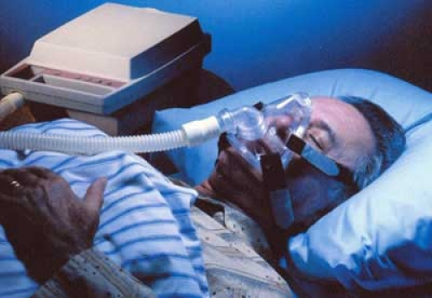

Slide 92
Nursing Interventions (cont.)
Provide comfort measures to promote sleep
Administer sleep medications as ordered
Provide nutritional supplements that aid sleep
Promote emotional comfort by spending time listening to concerns
Observe patients for patterns of fatigue or napping throughout the day

Slide 93
Provide Comfort Measures to Promote Sleep
Notes:
See Figure 20-2 on p. 334.

