Slide 1
Chapter 7
The Toddler

Slide 2
Key Terms
Autonomy
Baby bottle tooth decay
Cariogenic
Corrosive
Defecation
Denver II
Egocentric
Fluorosis
Hydrocarbons
Hyperpnea
Increased respiratory rate
Negativism
Parallel play
Phagocytosis
Physiological anorexia
Pica
Rickets
Ritualism
Temper tantrum

Slide 3
Chapter 7
Lesson 7.1

Slide 4
Learning Objectives
Define the vocabulary terms listed
Describe the physical and psychosocial development of children from 1 to 3 years of age, listing age-specific events and guidance when appropriate
Discuss how adults can help small children combat their fears
Identify five strategies that aid in meeting a toddler’s nutritional needs
Identify the principles of toilet training (bowel and bladder) that assist in guiding parents’ efforts to provide toilet independence
Discuss questions to use in evaluation of daycare centers

Slide 5
General Characteristics and Development

Slide 6
Developmental Tasks
Toddlers: 1-3 years of age
Parents no longer accept the child’s actions without question
    Temper tantrums
    Negativism
      Saying “no” frequently
    Ritualism
      Establishes a sense of security and control
    Egocentric thinking
Beginning to differentiate themselves from mother
  Separation from parents still their greatest fear
Self-regulatory functions
  Toilet independence, eating, sleeping, etc.
Notes:
Toddlers become very frustrated with the new concept of rules for behavior.
Toddlers will also dawdle to feel in control of when/where they go.
Toddlers need to be encouraged to become independent, and the caregiver should not do everything for them.
(Separation) Parents should never “sneak out” on a child.
Learning to delay gratification and incorporate socially acceptable behavior.

Slide 7
Developmental Tasks
Erik Erikson (psychosocial)
  Toddler age: Learning autonomy vs. shame or doubt
  Encourage independence
Lawrence Kohlberg (moral)
  Toddlers beginning to formulate a sense of right/wrong
  Obey only because parents tell them to
Sigmund Freud (personality)
  “Anal phase”
  Child learns to control urination and defecation

Slide 8
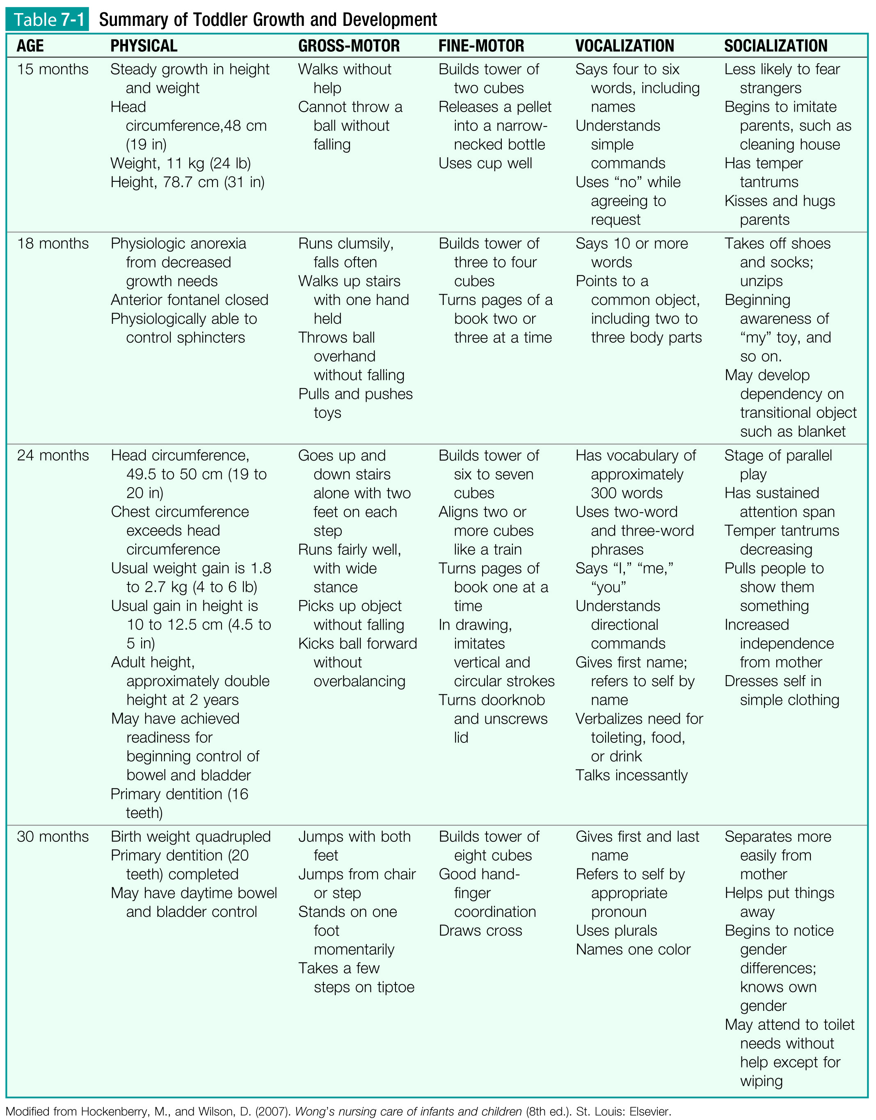

Slide 10
Notes:
The hospital can be frightening to a toddler. A parent’s presence is often reassuring.

Slide 11
Physical Growth
Weight gain: 4-6 pounds per year
Height increase: ~5 inches per year
Legs and arms lengthen
  Ossification, epiphyseal growth
Chest circumference continues to increase
Growth of trunk, head, and brain decelerate
Improved immunity
  Phagocytosis working more effectively
By 2 years:
  Myelination of the spinal cord practically complete
    Allows control of anal/urethral sphincters
  Visual acuity ~20/40
Notes:
At what age are all 20 deciduous teeth generally present?
Toddlers have improved thermoregulatory capabilities.

Slide 12
Guidance and Discipline
Wide range of fluctuating emotions
  Trying to assert independence
  Love one minute, hate the next
Rituals play an important part in toddlers’ ability to achieve independence
Discipline
Time outs
  1 minute per year of age, up to 5 minutes
  Can change almost any disruptive childhood behavior
  Most effective over 2 years of age
Spanking is controversial
Providing approval helps increase self-confidence
Notes:
What is one of the objectives in the management of toddlers?
Parents should help toddlers find socially acceptable outlets for expressing their emotions.
Positive parenting steps also include spending time alone with the toddler, praising the toddler for good behavior, and making the child feel safe and secure through discipline and love.

Slide 13
Communication
Language development
  “Ma-ma”/”pa-pa,” etc., by end of first year
    Positive reinforcement and praise are essential when children start speaking
  2-year-olds: simple two-word noun-verb sentences
  3-year-olds: generally three-word sentences
  Comprehension of tone and facial expression
  “No” is an important word to toddlers
    Express developing autonomy
  Delayed speech does not necessarily indicate that a child is mentally slow
  Denver II
    Assesses developmental status of children during their first 6 years
    Personal-social, fine motor-adaptive, language, gross motor
Notes:
What is the Denver Developmental Screening Test (DDST)?
No two toddlers have the same vocabulary at the same age; however, generalities are found in language development.
It is important to remember that toddlers who talk well still cannot comprehend much of adult conversation. Children should never be punished for misunderstanding commands.

Slide 14
Communication
Communicating with toddlers
  Keep everyday conversation simple
  Be mindful of eye level
  Use the “I message” to avoid criticism and blame
    “I feel angry when you hit your sister”
Notes:
Why should the word “bad” not be used when communicating with a toddler?

Slide 15
Health Promotion and Maintenance

Slide 16
Daily Care
Proper nutrition, fresh air, exercise, sufficient rest
Structure and routine are important
Clothing
  Simple, easy for them to put on/take off
  Shoes with flexible soles
They may sunburn quickly and should be protected by clothing and/or sunscreen to prevent future skin damage
Sleep needs gradually decrease as children grow older
Adjust environment to their size
Notes:
A flexible schedule organized around the needs of the entire household is best.
Why should children wear their everyday shoes at their periodic checkups?
According to the American Academy of Pediatrics, the sunscreen SPF (sun protection factor) should be at least 15.

Slide 17
Dental Health
Prevention of dental problems
  Good nutrition, proper brushing/flossing of the teeth, regular dental care
  Baby bottle tooth decay
  Parents of limited income may fall behind in dental health practice
The American Academy of Pediatrics Dentistry and the American Dental Association recommend children see a dentist:
  within 6 months of the first primary tooth eruption
  no later than at 12 months of age
Notes:
An easy way to remember how many teeth young children should have is the age of the toddler in months minus 6.
Attractive, healthy teeth promote self-esteem and contribute to physical well-being.
Why does baby bottle tooth decay occur?

Slide 18
Dental Health
Fluoride
City water typically contains fluoride
  Supplementation is available if levels are inadequate
Fluoride should be given until the last permanent tooth erupts
Toothpaste
Children under 2 should not use fluoride toothpaste
  Can cause fluorosis, mottling of teeth
Be sure children use a pea-sized amount
Brush at least twice a day
Notes:
Last permanent tooth erupts ~12 years old.
Allow the toddler to experience and handle frustration as brushing technique is learned.
Assist until school age to ensure effectiveness.

Slide 19
Nutrition Counseling
General nutritional requirements (MyPyramid)
Diet low in saturated fats, trans fats, cholesterol, salt, added sugars
Caloric requirements
  1000-1400 for children 2-3 years
Milk, up to 2-3 cups daily
  Whole milk until 2 years, then low-fat or skim
Children 1-3 years are high-risk candidates for anemia
  Ensure adequate intake of solid foods
Limit fruit juice
  Up to 4-6 oz/daily for children 1-6 years
Rickets: Vitamin D deficiency, limited sunshine exposure
Notes:
2-3 healthy snacks during the day
Example 1000-calorie day: 1 cup each fruit/veg, 3 oz grains, 2 oz meat/beans, 2 cups milk, 3 tsp oil, 165 cal of snacks
Whole milk is recommended in the first 2 years for its fat content.
Drinking too much milk takes away from solid foods necessary for iron intake.
Toddlers are at risk for choking on foods such as grapes, frankfurters, and raw vegetables.
MyPyramid (Figure 7-5) was introduced by the U.S. Department of Agriculture in 2005 to encourage people to make healthy food choices and to be active every day.

Slide 20
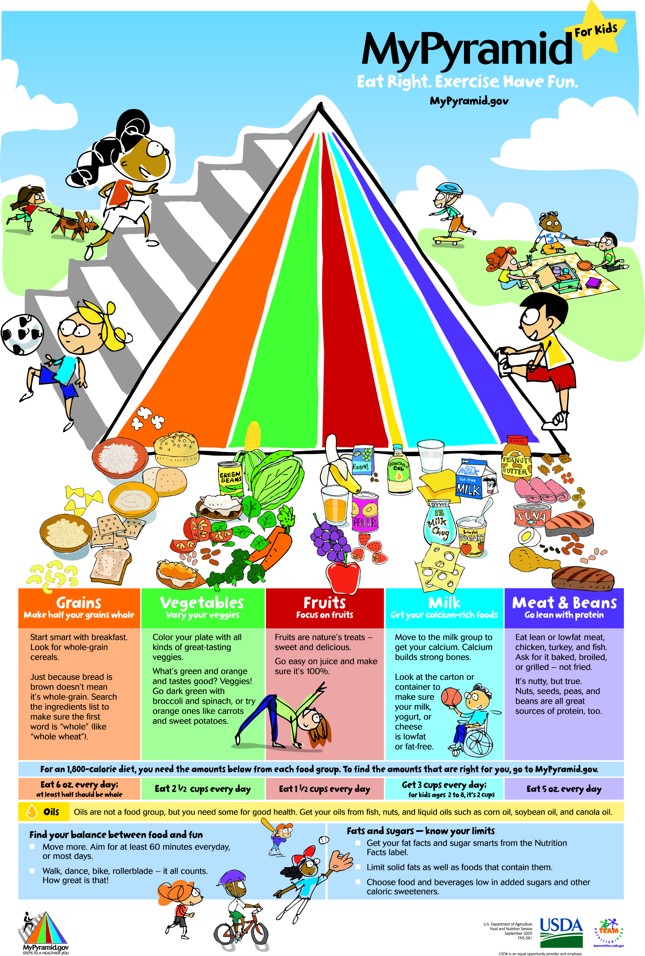

Slide 21
Nutrition Counseling
Toddlers have naturally fluctuating appetites and food preferences
  Physiological anorexia: decreased appetite and nutritional need
Avoid overwhelming toddlers with large portion size
Accept abrupt changes in preference
Accept short attention spans during mealtime if adequate nutrition is consumed
Make mealtime fun with colorful, child-safe dining ware
Promote low-cariogenic snack foods
Notes:
What is physiological anorexia?
Remind parents that any nutritious food can be eaten at any meal if the toddler prefers; for example, soup for breakfast, eggs for supper.

Slide 22
Toilet Independence
Voluntary control of anal/urethral sphincters
  ~18-24 months
Children must be able to communicate that they are wet or need to urinate/defecate
Bowel training is generally attempted first; however, some toddlers become bladder-trained during the day because they enjoy listening to the “tinkle” in the potty
Bladder training is begun when the toddler stays dry for about 2 hours at a time
Notes:
If the child does not seem to catch on after a couple of weeks, parents need to accept that the child is not ready yet, and they should not make the child feel bad.
Most children continue to have occasional accidents until the age of 4 or 5 years.

Slide 23
Toilet Independence
Training pants
  Child becomes more aware of being wet
  Easy on/off
Potty chair
  Makes toddlers feel secure because of small size
  Child’s feet should touch the floor
  Allowing the child to play with the chair before its intentional use eases the transition
Regular toilet
  Sitting facing the toilet tank gives the child a greater feeling of security
Notes:
How long should the child be left on the potty chair or toilet?

Slide 25
Question 7.1
Rickets is the result of:
Vitamin D deficiency
Vitamin K deficiency
Too much vitamin D
Too much vitamin K
Notes:
Answer: A

Slide 26
Play
The importance of play
  Develops coordination
  Relief from emotional tension
  Educational value
Parallel play: Playing near other children, not with them. Beginning of socialization
As toddlers learn to communicate and become more skilled in handling toys, cooperative play takes place
  Sharing takes time
  Adult supervision during play is important for feelings of security
Notes:
Toys with small, removable parts are dangerous because of the risk for aspiration.
As a general rule, how large should the toddler’s toys be?
Toys that can be pedaled, such as a tricycle, should be adapted to the size of the child.

Slide 27
Play
Toy preference varies with age
Toddlers enjoy toys that imitate their parents
  Lawnmowers, housekeeping, etc.
Use of imagination is important
  Toys do not need to be expensive
Avoid small removable parts
  All toys should be larger than the child’s fist

Slide 28
Daycare
Common for children under 6 years
  More mothers returning to work
  Returning to work sooner—younger children in daycare
Parents must take an active role in ensuring high-quality care
  Consider precautions taken by the daycare center to prevent disease transmission
  Inquire whether the center is licensed, staff members’ qualifications?
Notes:
What are the two types of child care?
Ideally, all future daycare programs might include comprehensive health services and health education programs.

Slide 29
Question 7.2
Parallel play is:
Toddlers learning to share
Preference for playing with familiar children
A sign of antisocial tendencies later in life
The beginning of socialization
Notes:
Answer: D

Slide 30
Chapter 7
Lesson 7.2

Slide 31
Learning Objectives
Discuss the use of car seats with toddlers
Identify four potential safety hazards specific to the toddler and anticipatory guidance for caretakers in preventing such accidents
Discuss care of the child with poisonings (acetaminophen, ibuprofen, aspirin, lead, hydrocarbons, and corrosives)

Slide 32
Injury Prevention
Accidents: Leading cause of childhood death
Toddlers have natural curiosity for investigating their environment
  Parents should understand their child’s activities at certain ages, they can take necessary precautions and prevent many serious injuries
  E.g.: when statistics indicate that poisonings/burns are particularly prevalent at a specific age
Government safety interventions
  Laws requiring automobile restraints
  Nonflammable material for children’s sleepwear
  Childproof caps on medicine bottles
  Maximum temperatures for hot water bottles
  Regulations for crib manufacturing
Notes:
Toddlers are at the highest risk for having what kinds of accidents?
Most accidents occur in or near the home.
Nurses in the community often can contribute indirectly to the welfare of others by the example they set and by being aware of emergency medical facilities available in the community.

Slide 33
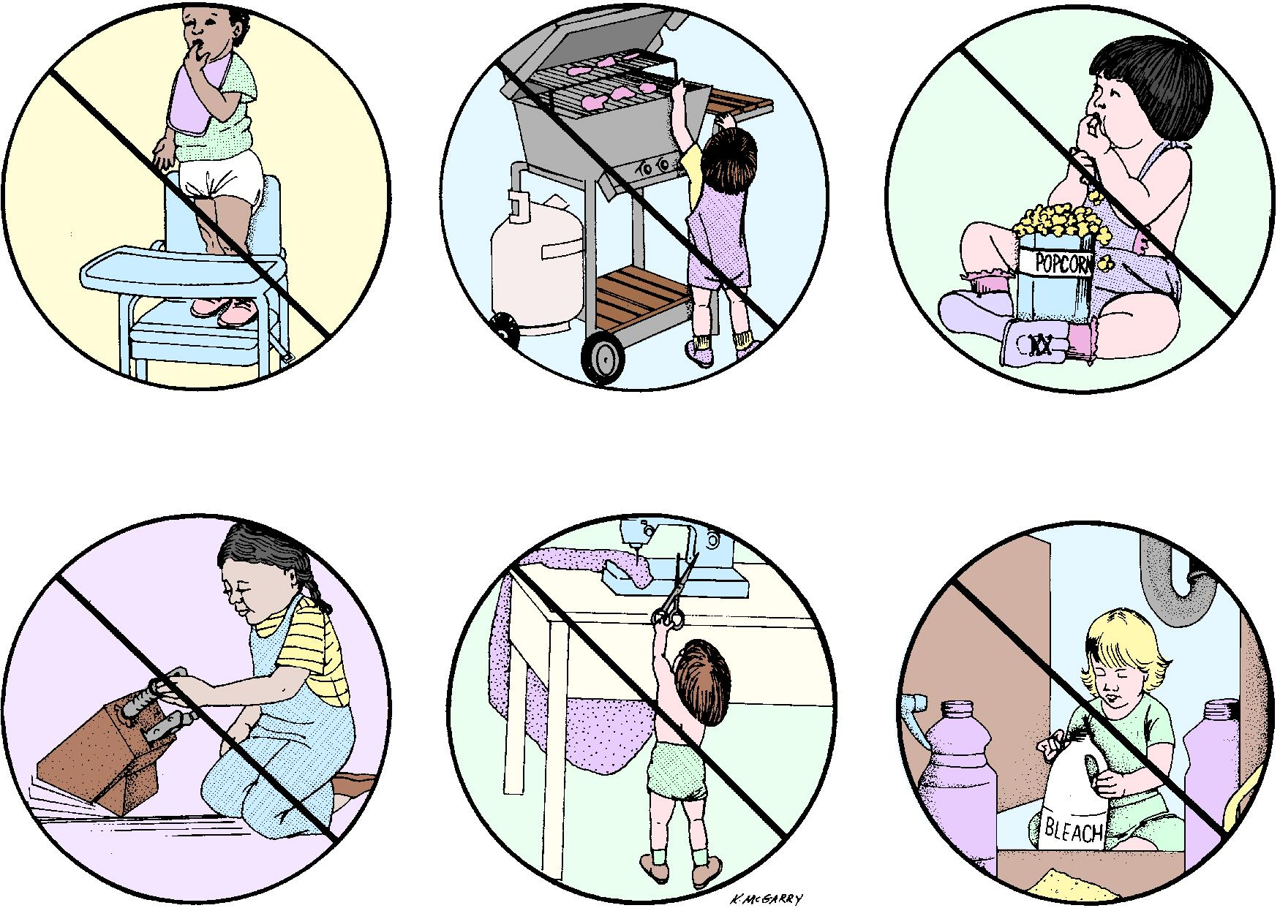

Slide 34
Injury Prevention
Toddlers are at risk for being hit by a car while playing in their own driveways
Parents should never to turn their back on a child near water
  Whether in a tub or standing near a body of water
Scald burns are the most common type of burn injury in children
Electrical outlets should have safety guards to prevent harm
Notes:
Before drivers start the car, they must be aware of any nearby children and pay attention to the children’s locations.
What are the most common ways a child may receive a scald burn?

Slide 35
Injury Prevention
All potentially dangerous substances should be placed out of the child’s reach and locked up
For prevention of falls, all doors, windows, and gates should be kept closed or guarded with a screen
Coins, pins, removable toy parts, deflated balloons, and hard foods are common causes of choking
Parents should be taught cardiopulmonary resuscitation (CPR) and abdominal thrusts
Notes:
When should the parents consider moving a child from the crib to a bed?
Children should be taught how to safely play when on playground equipment or riding toys.

Slide 36
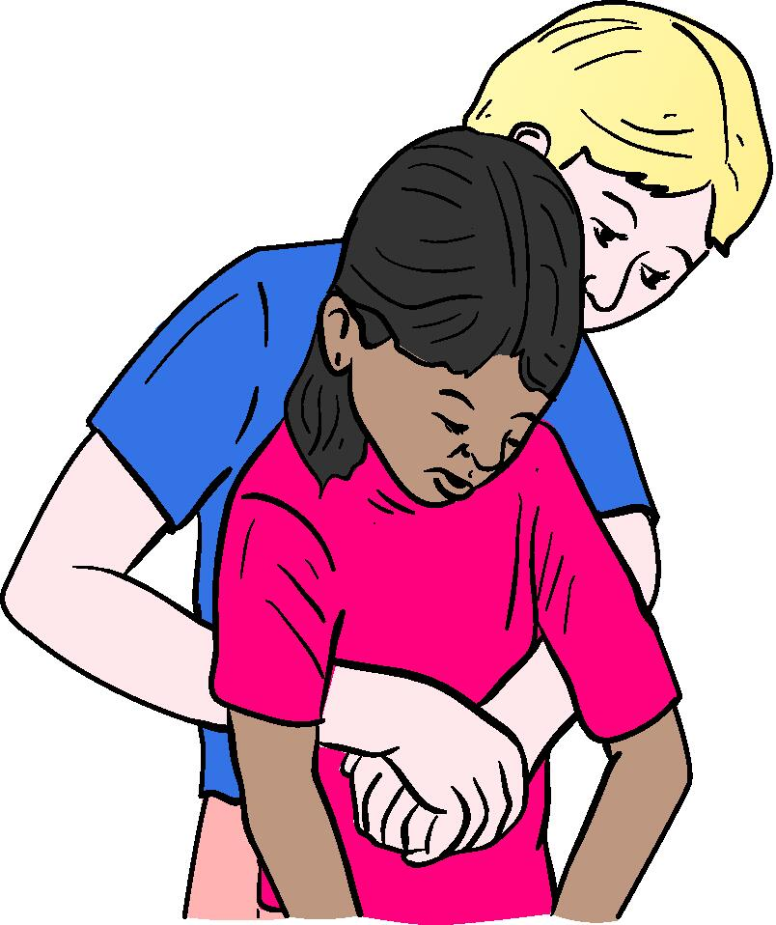

Slide 37
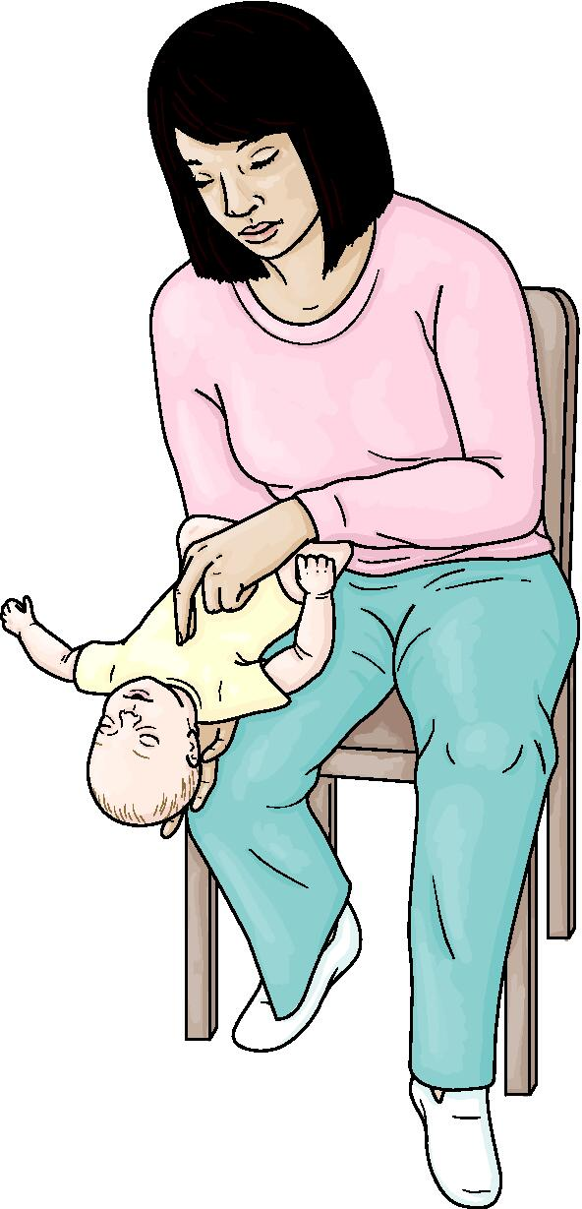
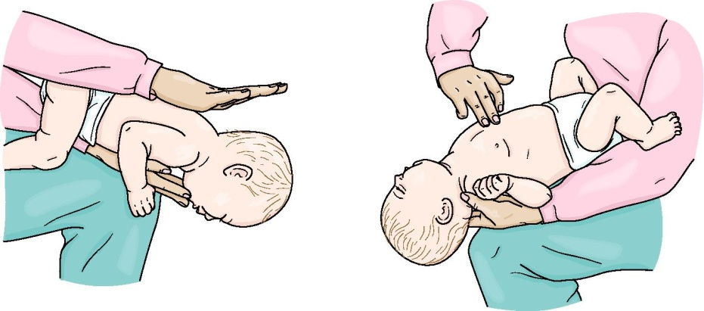

Slide 38
Car Safety Seats
Children younger than 1 year / less than 20 lbs
  Rear-facing car seats
  Middle of the back seat
Children older than 1 year / 20-40 lbs
  Sit forward in a convertible safety seat
Children weighing 40-80 lbs
  Forward-facing only seats with a harness
  Harnesses should be used until at least 4 years of age
Booster seats
  Children who have outgrown their forward-facing seats
Ages 12 and younger should never ride near an airbag
Notes:
Motor vehicle accidents are the number-one cause of childhood death from injury after age 1.

Slide 39
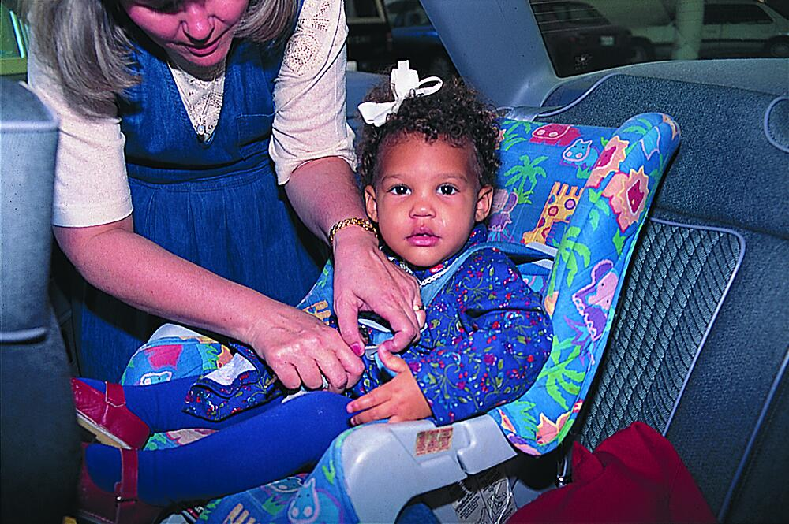

Slide 40
Fire and Burn Prevention
Smoke detectors
  Required in new homes
  Recommended in older homes
Hazard prevention/unsafe situations
  Pulling hot liquids down (tugging at tablecloths, etc.)
  Accidentally turning hot water knob during tub play
  Hot water heater no higher than 120º F
  Keep matches/lighters out of reach
  Electrical outlet safety guards
Notes:
Scald burns are the most common type of burn injury.

Slide 41
Injury Prevention
Drowning
Caretakers should never turn their back on a child near any body of water
All parents should be trained in CPR
Choking
Young children don’t understand not to put small items into their mouths
  Nuts, popcorn, hard candy, coins, deflated balloons, etc.
Heimlich for conscious children older than 1 year
Back slaps and chest thrusts for conscious infants
Notes:
Situations from toilets to swimming pools to small containers holding water pose a serious drowning hazard.

Slide 42
Injury Prevention
Playgrounds and falls
  Teach children to use playground equipment safely
  Keep doors/windows/gates closed or screened
  Switch to a bed when crib climbing begins
Notes:
American Association of Poison Control Centers’ nationwide poison control hotline is 1-800-222-1222.

Slide 43
Question 7.3
Children younger than what age should never sit in front of an airbag?
10
11
12
13
Notes:
Answer: C

Slide 44
Poisoning
Their curiosity puts young children at a high risk for poisoning
Poisoning prevention
  Keep all dangerous substances locked out of reach
  Parents should receive anticipatory guidance from the nurse for each age group’s risk factors
  Syrup of ipecac is no longer used
Notes:
Parents should always have poison control # available.
1-800-222-1222

Slide 45
Poisoning
Emergency care
  Call 911 if the child is not breathing
  Activated charcoal binds with most poisonous compounds
    Does not bind to metals, ethanol, caustics, many hydrocarbons (i.e., gasoline, paint thinner)
  Ingestion of corrosives
    Dilute with water or milk
    Never induce vomiting for corrosives or hydrocarbons
The family
  Nurses should not reinforce parental feelings of guilt
  Avoid preventive teaching until the acute stage has passed
Notes:
Gastric lavage has little to no benefit 30 min. after ingestion.
Typically not used with hydrocarbons because of aspiration risk.
Some children need a tracheostomy to maintain an airway after consuming corrosives.
Immediate danger of hydrocarbons.
Aspiration, tachypnea, cyanosis.
Follow-up treatments may include electrolyte studies, IVs, temperature control measures, cardiac monitoring, respiratory treatment, dialysis.

Slide 46
Acetaminophen Poisoning
Widely accessible, most common drug poisoning
Liver damage is a major concern
Signs and symptoms
  Four stages of acetaminophen poisoning
Treatment and nursing care
  Administer N-acetylcysteine (Mucomyst) ASAP
    Offensive-smelling, child needs nurse support
  Active charcoal within 1-2 hours of ingestion
Notes:
Acetaminophen = Tylenol
Children under 6 are less likely to have significant toxic effects than older children or adults.
Mucomyst may be started 24-36 hours after ingestion in severe cases.
Administered according to serum acetaminophen level.
May be given via IV, but higher risk of anaphylaxis.

Slide 47
Salicylate Poisoning
Aspirin is generally avoided in children
  Reye’s syndrome
Salicylates occur in other medications also
  Some antihistamines/decongestants, Pepto-Bismol
Signs and symptoms
Vary with acute and chronic ingestion
Hyperpnea: faster/deeper respirations
Treatment and nursing care
Gastric emptying, preventing further absorption, relieving symptoms
Activated charcoal
Dialysis may be necessary
Notes:
Aspirin toxicity can occur from a single toxic-level ingestion or repeated small therapeutic doses.
Poisoning may manifest with ringing in the ears, dizziness, anorexia, sweating, nausea, vomiting, and diarrhea.
Hyperpnea is a sign of more serious trouble.
Respiratory system is stimulated by the drug.
Dehydration, metabolic acidosis, high fever, convulsions, and coma may follow.

Slide 48
Question 7.4
When a child has ingested paint thinner, which of the following procedures may be included in emergency care?
Induce vomiting with syrup of ipecac
Activated carbon
Induce vomiting, but not with syrup of ipecac
None of the above
Notes:
Answer: D

Slide 49
Ibuprofen Poisoning
Seizures and coma can occur with toxic levels
Renal function and acid-base balance are monitored
Treated with activated charcoal
Notes:
Nausea, vomiting, epigastric pain, drowsiness, lethargy, and ataxia are common overdose effects.

Slide 50
Lead Poisoning (Plumbism)
Public awareness has reduced daily lead exposure
Exposure: soil contamination, paint chips/dust, lead solder in older plumbing, improperly glazed earthenware
Highest prevalence in inner-city children with pre-1970s houses
Signs and symptoms
Anemia, stomachaches, muscle weakness, lead deposits in long bones
Children with pica have a higher lead exposure risk
Notes:
Some folk remedies contain lead: Azarcon and greta used for upset stomach, pay-looah for rash/fever.
Unborn children exposed to lead: premature birth, smaller babies, decreased mental ability, reduced growth.
Pica: eating things most people consider unpalatable (sand, grass, wool, glass, animal droppings, paint chips, etc.).
Underlying nutritional disturbance, family dysfunction, or mental health.

Slide 51
Lead Poisoning (Plumbism)
Treatment and nursing care
  CDC recommends blood testing for children who may be exposed to lead
  10 mcg/dL: elevated
  20-44 mcg/dL: medical evaluation, environment investigation
  45 mcg/dl : medical treatment may be necessary
    Considered moderate to severe
    Remove child from source of lead
    Administer chelating agent
  Plumbism residual effects range from none to severe encephalopathy
Notes:
Chelating agents have potentially serious side effects.

Slide 52
Lead Poisoning (Plumbism)
Nursing care is symptomatic
  Avoid unnecessary handling
  Rotate injection sites
    Evaluate skin for thickness of fibrous lumps
  Therapeutic syringe play is advised
  Observe/chart all seizures
  Report indications of respiratory distress

Slide 53
Question 7.5
Children with pica have an increased risk for lead exposure because:
Pica is a sign of dysfunctional parenting.
Mentally ill children are more sensitive to lead.
Pica is actually a result of lead poisoning.
Children with pica are more likely to ingest paint.
Notes:
Answer: D

