Slide 1
Chapter 6
The Infant

Slide 2
Key Terms
Deciduous teeth
Encephalopathy
Extrusion reflex
Grasp reflex
Parachute reflex
Pincer grasp
Rooting reflex
Weaning

Slide 3
Chapter 6 Lesson 6.1

Slide 4
Learning Objectives
Define the vocabulary terms listed
Discuss general characteristics of the infant, including reflexes
Discuss the nutritional needs of growing infants
Describe the physical development of infants from 1 to 12 months
Describe the care and guidance of infants from 1 to 12 months
Describe four developmental characteristics of infants that predispose them to certain hazards
For example, “puts everything into mouth—danger of aspiration”
Discuss teething in infancy
Describe colic and recommendations for soothing a colicky baby

Slide 5
General Characteristics and Development

Slide 6
General Characteristics and Development
First year of life
Continuous period of growth and development
Pace fluctuates gradually between slow and rapid
Grasp reflex
Flexion occurs when one touches an infant’s palms
Disappears at about 3 months
Prehension
Grasping objects between fingers and opposing thumb
Occurs at 5 to 6 months
Follows an orderly sequence of development
Notes:
The most common cause for concern about a child is a sudden slowing in any aspect of development that is not typical for that age group.
Infants have inconsistent behavior during their first months.
Sucking is important to infants.
Pacifiers are important for babies receiving IV/G-button feeding.

Slide 7
General Characteristics and Development
Parachute reflex
Protective arm extension when a prone infant is suddenly thrust downward
Occurs at 7 to 9 months
Pincer grasp
Coordination of index finger and thumb
Well-established by 1 year

Slide 8
General Characteristics and Development
Love and security are vital for infants
Assure parents that responding to an infant’s needs is not “spoiling” the baby
Attentiveness allows the infant to develop a sense of trust
Sensory stimulation is essential
Notes:
Trust is key to developing a healthy personality.
Attentiveness and love from personnel are equally important when an infant is hospitalized.
Brain growth is the most critical organic achievement of infancy.

Slide 9
Physical Development, Social Behavior, Care, and Guidance
Human development cannot cleanly be categorized
Individual variations range around central norms
Infant height and weight should progress at approximately the same rate
These norms serve as indicators of an infant’s or child’s developmental progress
(See Table 6-1: Social Behavior, Physical Development, Care, and Guidance for the First 12 Months)

Slide 10
Question 6.1
Which of the following reflexes occurs when one touches an infant’s palm?
Rooting reflex
Grasp reflex
Prehension
Pincer grasp
Notes:
Answer: B

Slide 11
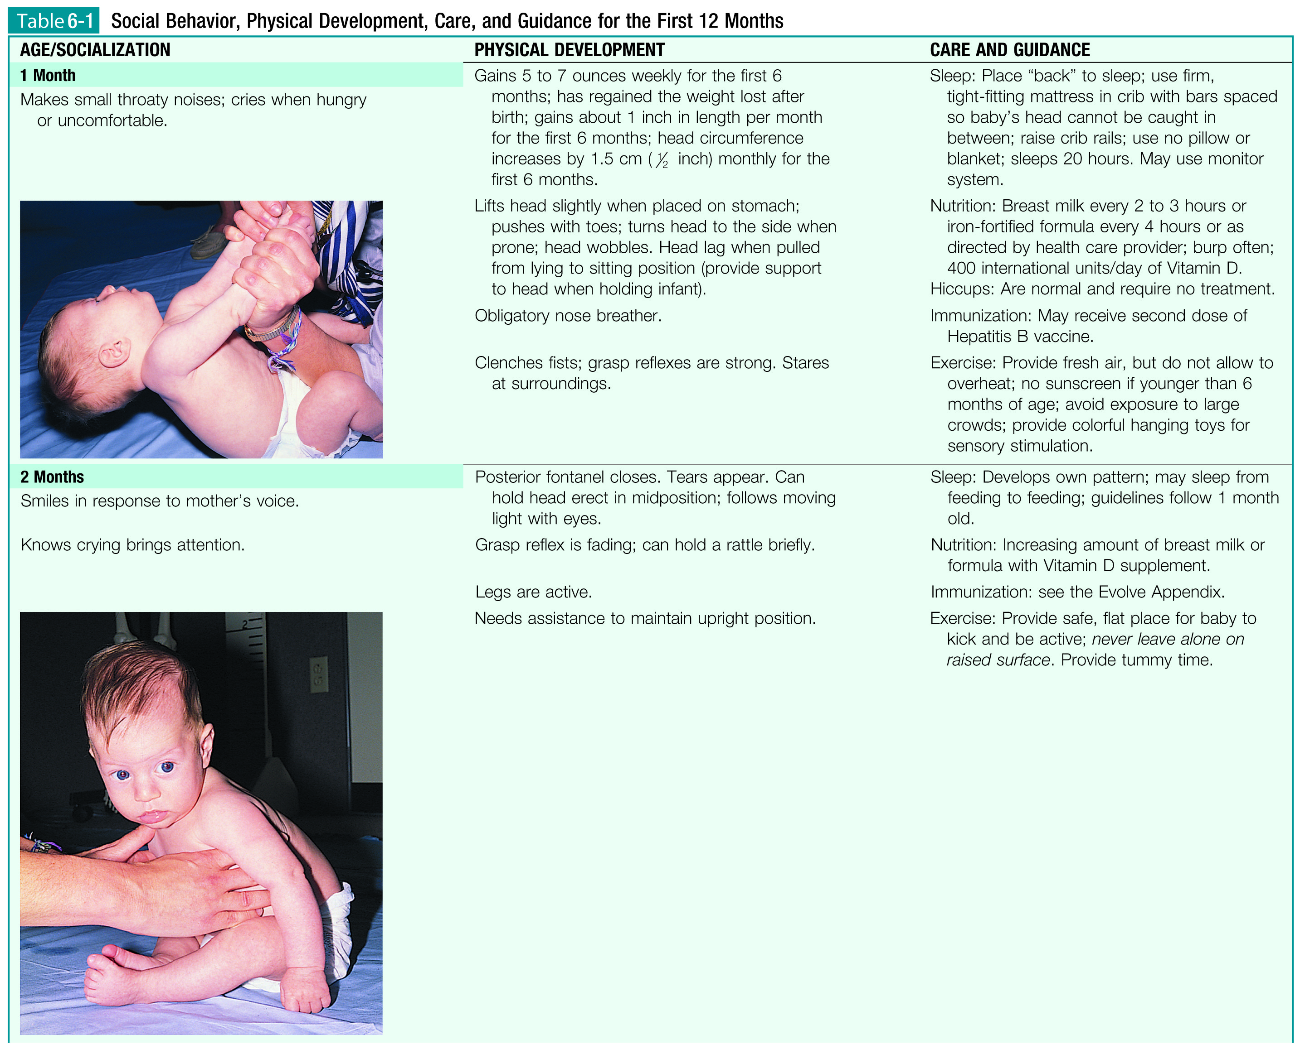

Slide 19
Health Promotion and Maintenance
Skilled health services available to parents
Periodic health appraisal
Evaluation of developmental milestones
Immunizations
Assessment of parent-child interactions
Counseling in the developmental processes
Health education
Etc.
Settings for health services
Private group practice
Hospital-based clinics
Etc.
Notes:
Promoting health and disease prevention during infancy
Very important
Includes all measures to improve physical health and psychosocial adjustment
What are “milk stations”?

Slide 20
Health Promotion and Maintenance
Some routine infant assessments
Growth charts should be maintained during infancy
See Appendix F
Developmental screening tests
Denver II Developmental Screening Test (Appendix G)
Physical examination
Hearing and vision
Notes:
Physicals are adapted to the needs of the infant.

Slide 21
Nutrition Counseling of Parents

Slide 22
Nutrition Counseling of Parents
Nutrient needs of infants
Rate of growth, energy expended, basal metabolic needs, interaction of nutrients consumed
Infants need 3x more energy than adults to maintain growth and development
Hydration and weight gain are signs of proper nutrition
Extrusion reflex
Pushes food out of the mouth to prevent intake of inappropriate food
Disappears ~3-4 months of age
Spoon-feeding
Difficult for most babies at first
Mastered by 2 years
Notes:
Infants should gain 4-7 ounces weekly for the first 6 months.
At least 6 wet diapers per day
What is the rooting reflex?
By 12 months, stomach has expanded from 10-20 mL to 200 mL.
What are four reasons whole cow’s milk is not recommended for infants younger than 1 year old?

Slide 23
Solid Foods
Introduced at about 4 to 6 months of age
Offer only small amounts at first (1 teaspoonful)
Cereal is usually followed by fruits and vegetables, then meat
New foods should be introduced one at a time, with 4 to 7 days between each new food
Temporarily omit refused foods; keep mealtime pleasant
Fruit juices are generally offered at about 9 months of age, when the infant begins to drink from a cup
Notes:
Rice cereal is recommended as the first solid food because it is less allergenic than others.
What factors should the introduction of solid foods be based on?
Never mix cereal with formula in a bottle.
Highly allergenic foods that may be delayed: fish, nuts, strawberries, chocolate, egg whites.

Slide 24
Buying, Storing, and Serving Food
Baby food in vacuum-packed jars
Unopened jars of baby food and juices should be stored in a dry, cool place
Do not feed the infant from the jar or return leftovers to the jar
Saliva may turn certain foods to liquid by digesting them in the jar
Special precautions should be taken to prevent burning when warming food in the microwave
Notes:
When a jar is opened, a definite “pop” sound should be heard as the vacuum seal is broken.
Always check expiration dates.
What technique should be used to test the warmth of food?

Slide 25
Weaning from the Breast
Mother deciding to discontinue breastfeeding
Infant may desire to breastfeed less often
Steps to reducing milk supply
Mother can decrease her fluid consumption
Decrease number of infant feedings
Limit length of feeding
Done gradually over several days or weeks
Usually completed by age 1 to 2 years
Notes:
When should weaning be started?
Weaning should not be attempted when the baby is ill.
Weaning from the breast is a changing point in the infant’s life, and efforts should be made to make this experience as comfortable and as pleasurable as possible.
In some cultures, breastfeeding may continue longer.

Slide 26
Teeth

Slide 27
Deciduous Teeth
20 deciduous/baby teeth
Erupt during the first 2½ years of life
Starts ~6 months of age
The 1-year-old has about six teeth
Four upper and two lower
Baby teeth usually shed in the order they appeared
Notes:
Deciduous teeth begin developing ~5th month of intrauterine life.
A delay in teething is significant if other forms of immaturity or illness are present.
How can the mother’s health and diet affect an infant’s teeth?

Slide 28
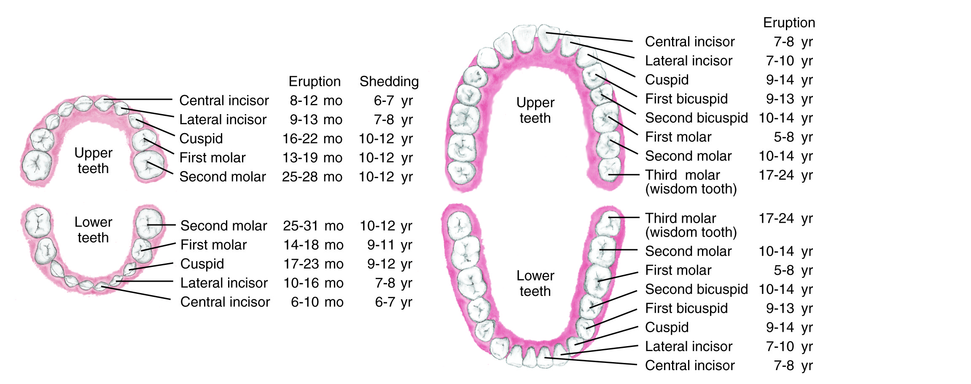

Slide 29
Teething During Infancy
Teething: Eruption of the crown of the tooth through the periodontal membrane
Gums: red, swollen, sensitive
Cold soothes inflamed gums
Infant may be fussy and wake during the night
Does not cause fever
Not responsible for respiratory tract infections, rashes, or diarrhea
Notes:
Calcium, phosphorus, vitamins C and D, and fluoride help ensure healthy teeth.

Slide 30
Teething During Infancy
Oral hygiene
Gently wipe gums and teeth with gauze or a clean washcloth every day
Bottle-mouth caries/nursing-bottle caries
Avoid milk or sweetened juice when putting infants to bed
Nocturnal nursing discouraged after 1 year of age
Gastroesophageal reflux
Gastric acids can erode dental enamel
Teeth can be protected with acrylic sealant
Notes:
Bottle-mouth caries/nursing-bottle caries—sugar pools in the oral cavity, causing severe decay.
Avoiding refined sugars is important when preventing tooth decay in infants.

Slide 31
Colic

Slide 32
Colic
Paroxysmal abdominal pain
Usually disappears by 3 months of age
Treatment
Sedatives, antispasmodics, antihistamines, antiflatulents
Parents should always consult a physician or nurse about age-appropriate medications
Positional changes: Prone over a heating pad
Pacifier
Abdominal massage
Burping frequently with feedings
Wind-up swings
Notes:
Crying at the same time each day
Legs drawn towards abdomen
Parents can also try going for a walk outdoors or a ride in the car.
Never smoke near an infant.

Slide 33
Question 6.2
Teething can be responsible for ___ in infants
Fever
Rashes
Fussiness
All of the above
Notes:
Answer: C

